Slide 1
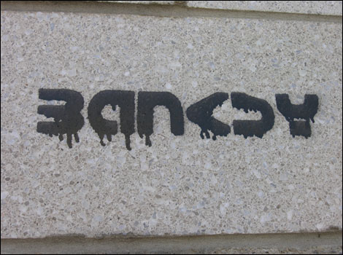
a
And Graffiti Art

Slide 2
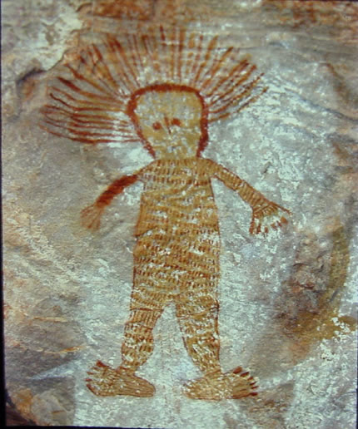
Art or Vandalism?..
Graffiti has been around for longer than you might think…..from ancient cave art of the aborigines'
To the modern day Graffiti seen in all cities and towns…

Slide 3
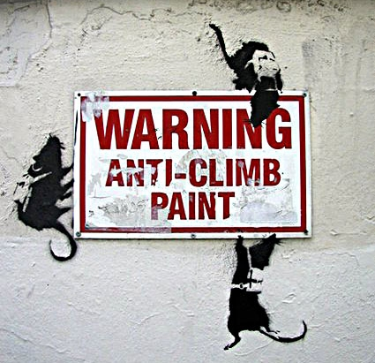
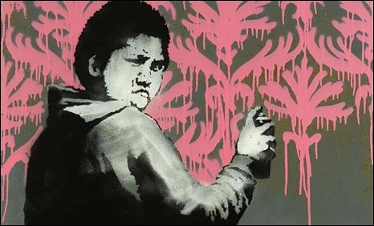
Graffiti has been viewed more as an act of vandalism than a work of art, but over recent years it has became more appreciated as public art.
Graffiti artists such as the Mysterious “Banksy” (Identity unknown) could have promoted Graffiti as art...

Slide 4
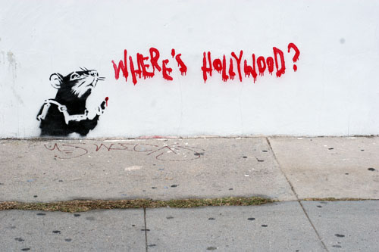
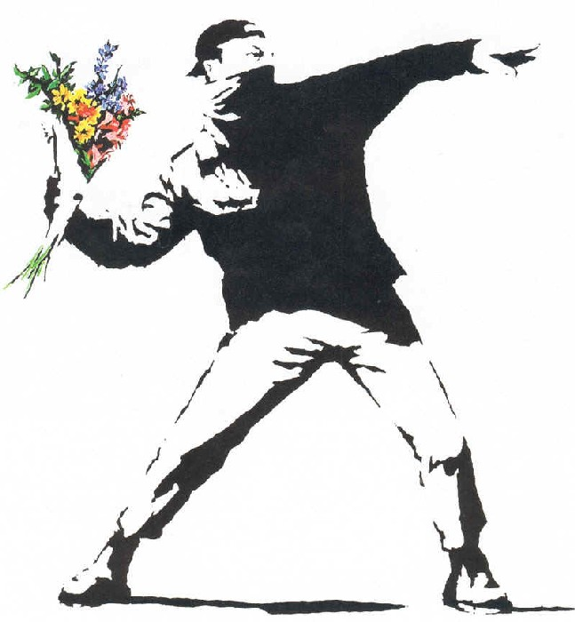
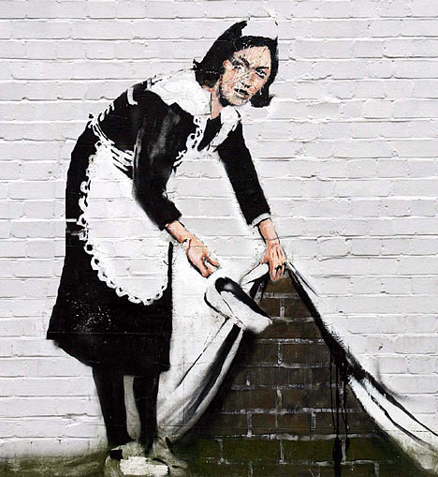
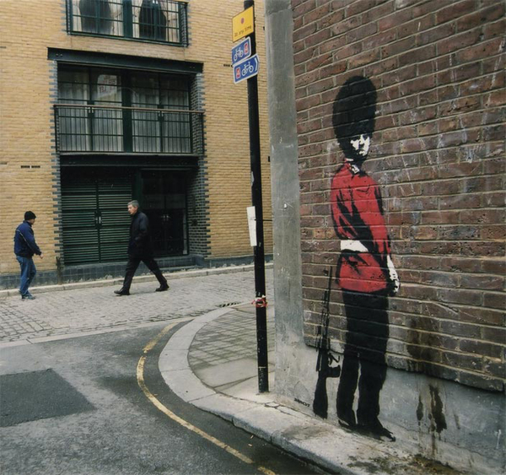
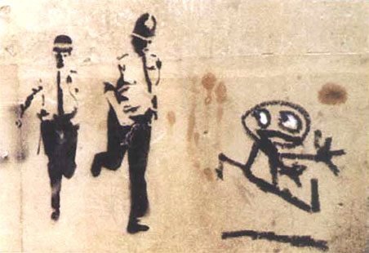
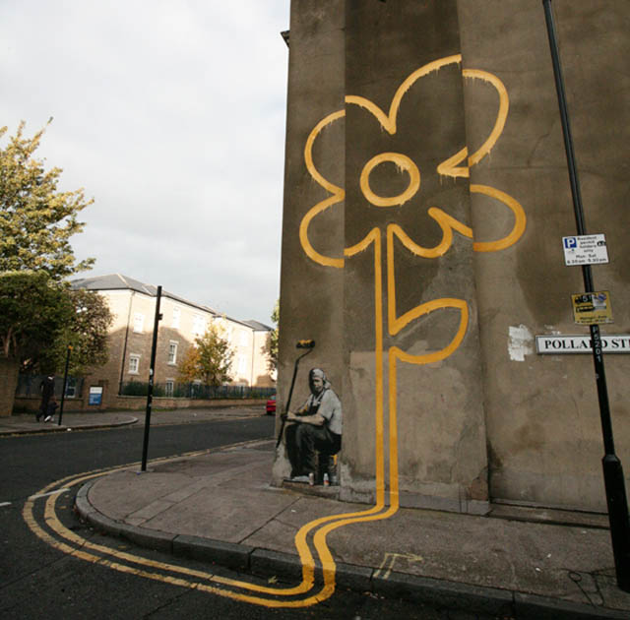
The work of

Slide 5
Banksy style Portrait
You are going to create your own Banksy style portrait.
You will create a Graffiti “tag” of your name
A stencil of your own portrait
A back ground to add the tag and the stencil image to, you could then have an image similar to this…….

Slide 6
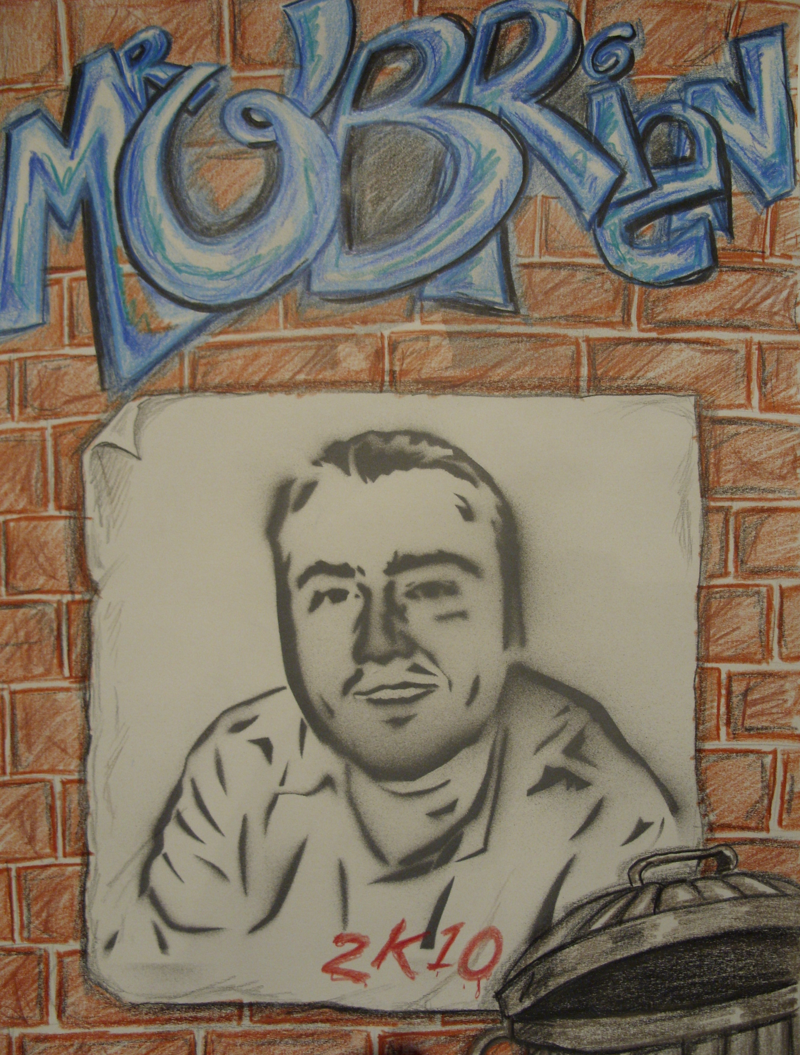
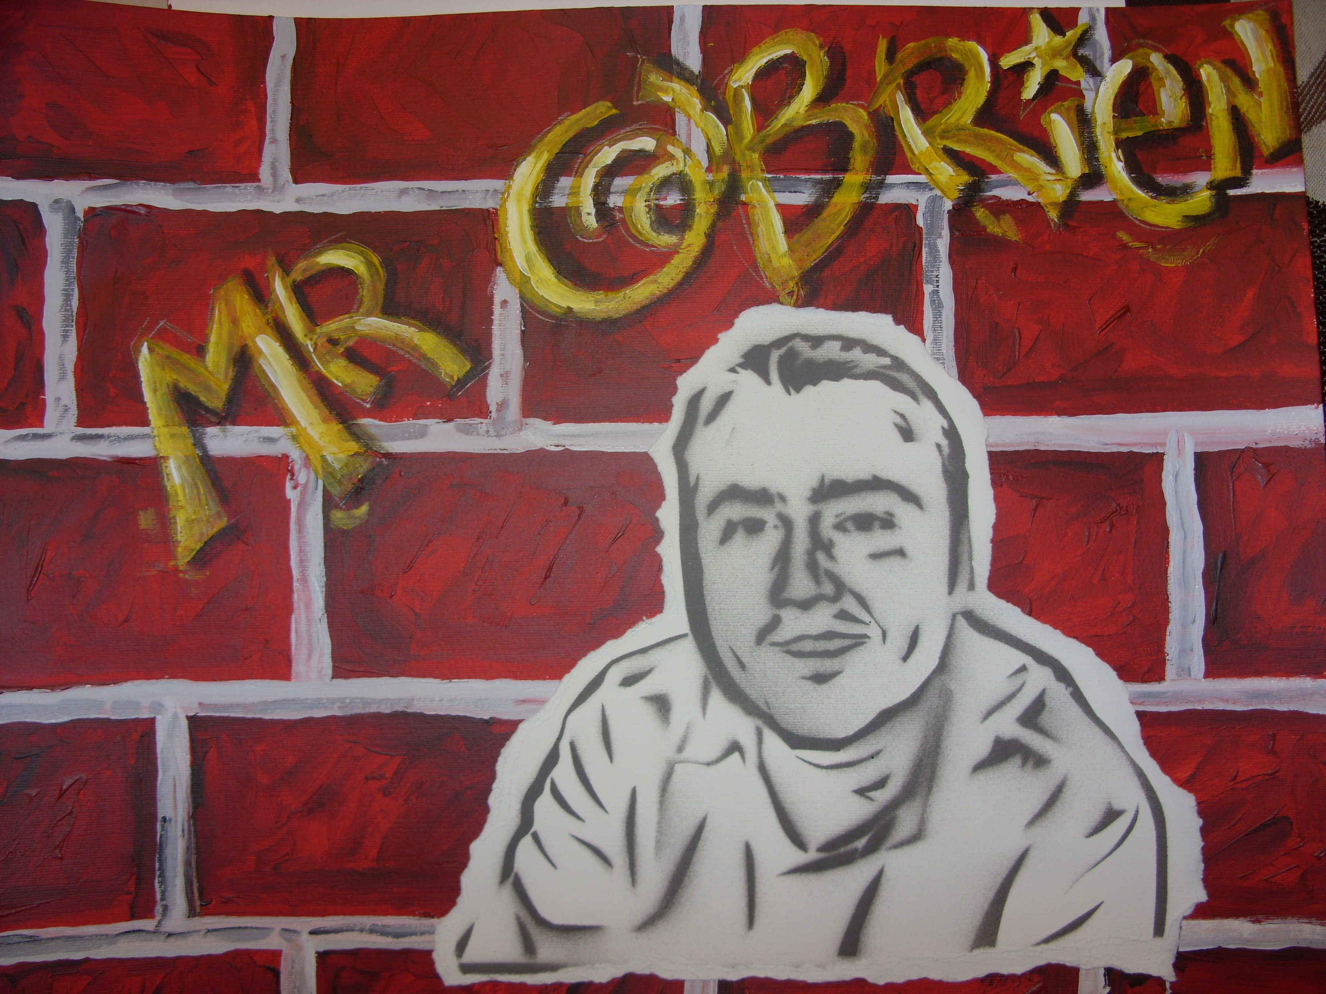
Your design can include much more detail and a better designed tag…and will obviously be a better looking subject!

Slide 7
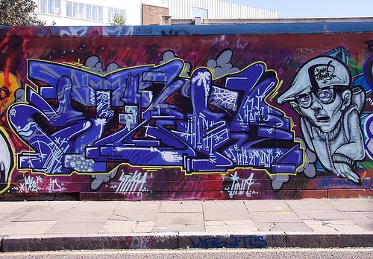
Graffiti Tag
A Graffiti Tag is your name or nickname usually drawn or sprayed on your work in a unique Graffiti style text.

Slide 8
Creating your Graffiti tag
You need to research Graffiti text (type of writing) and work out a design that you can use for your name, it can be as simple or as complex as you want.
There are websites that you can experiment with such as www.graffiticreator.net you could use this site as a starting point then develop your own style.

Slide 9
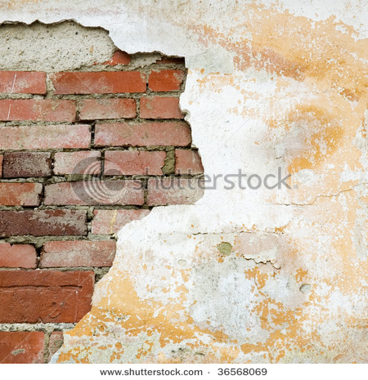
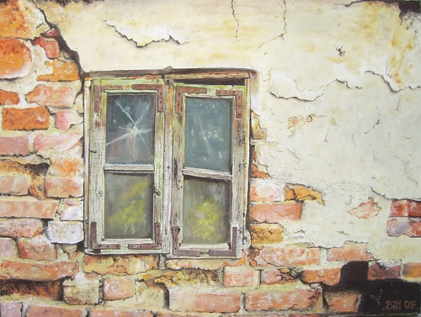
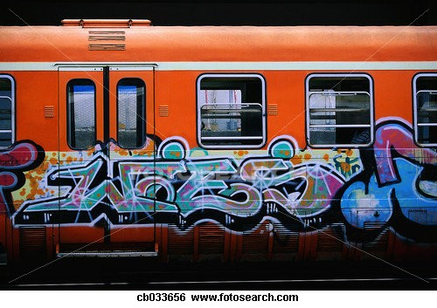
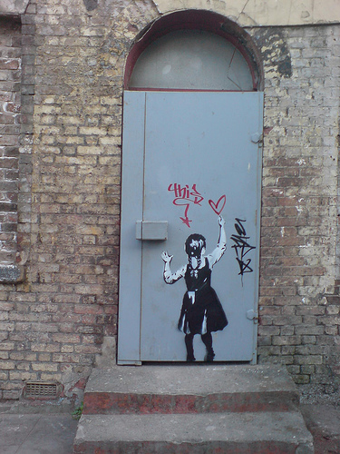
Background
You need to think of an eye catching back ground for your portrait….

Slide 10
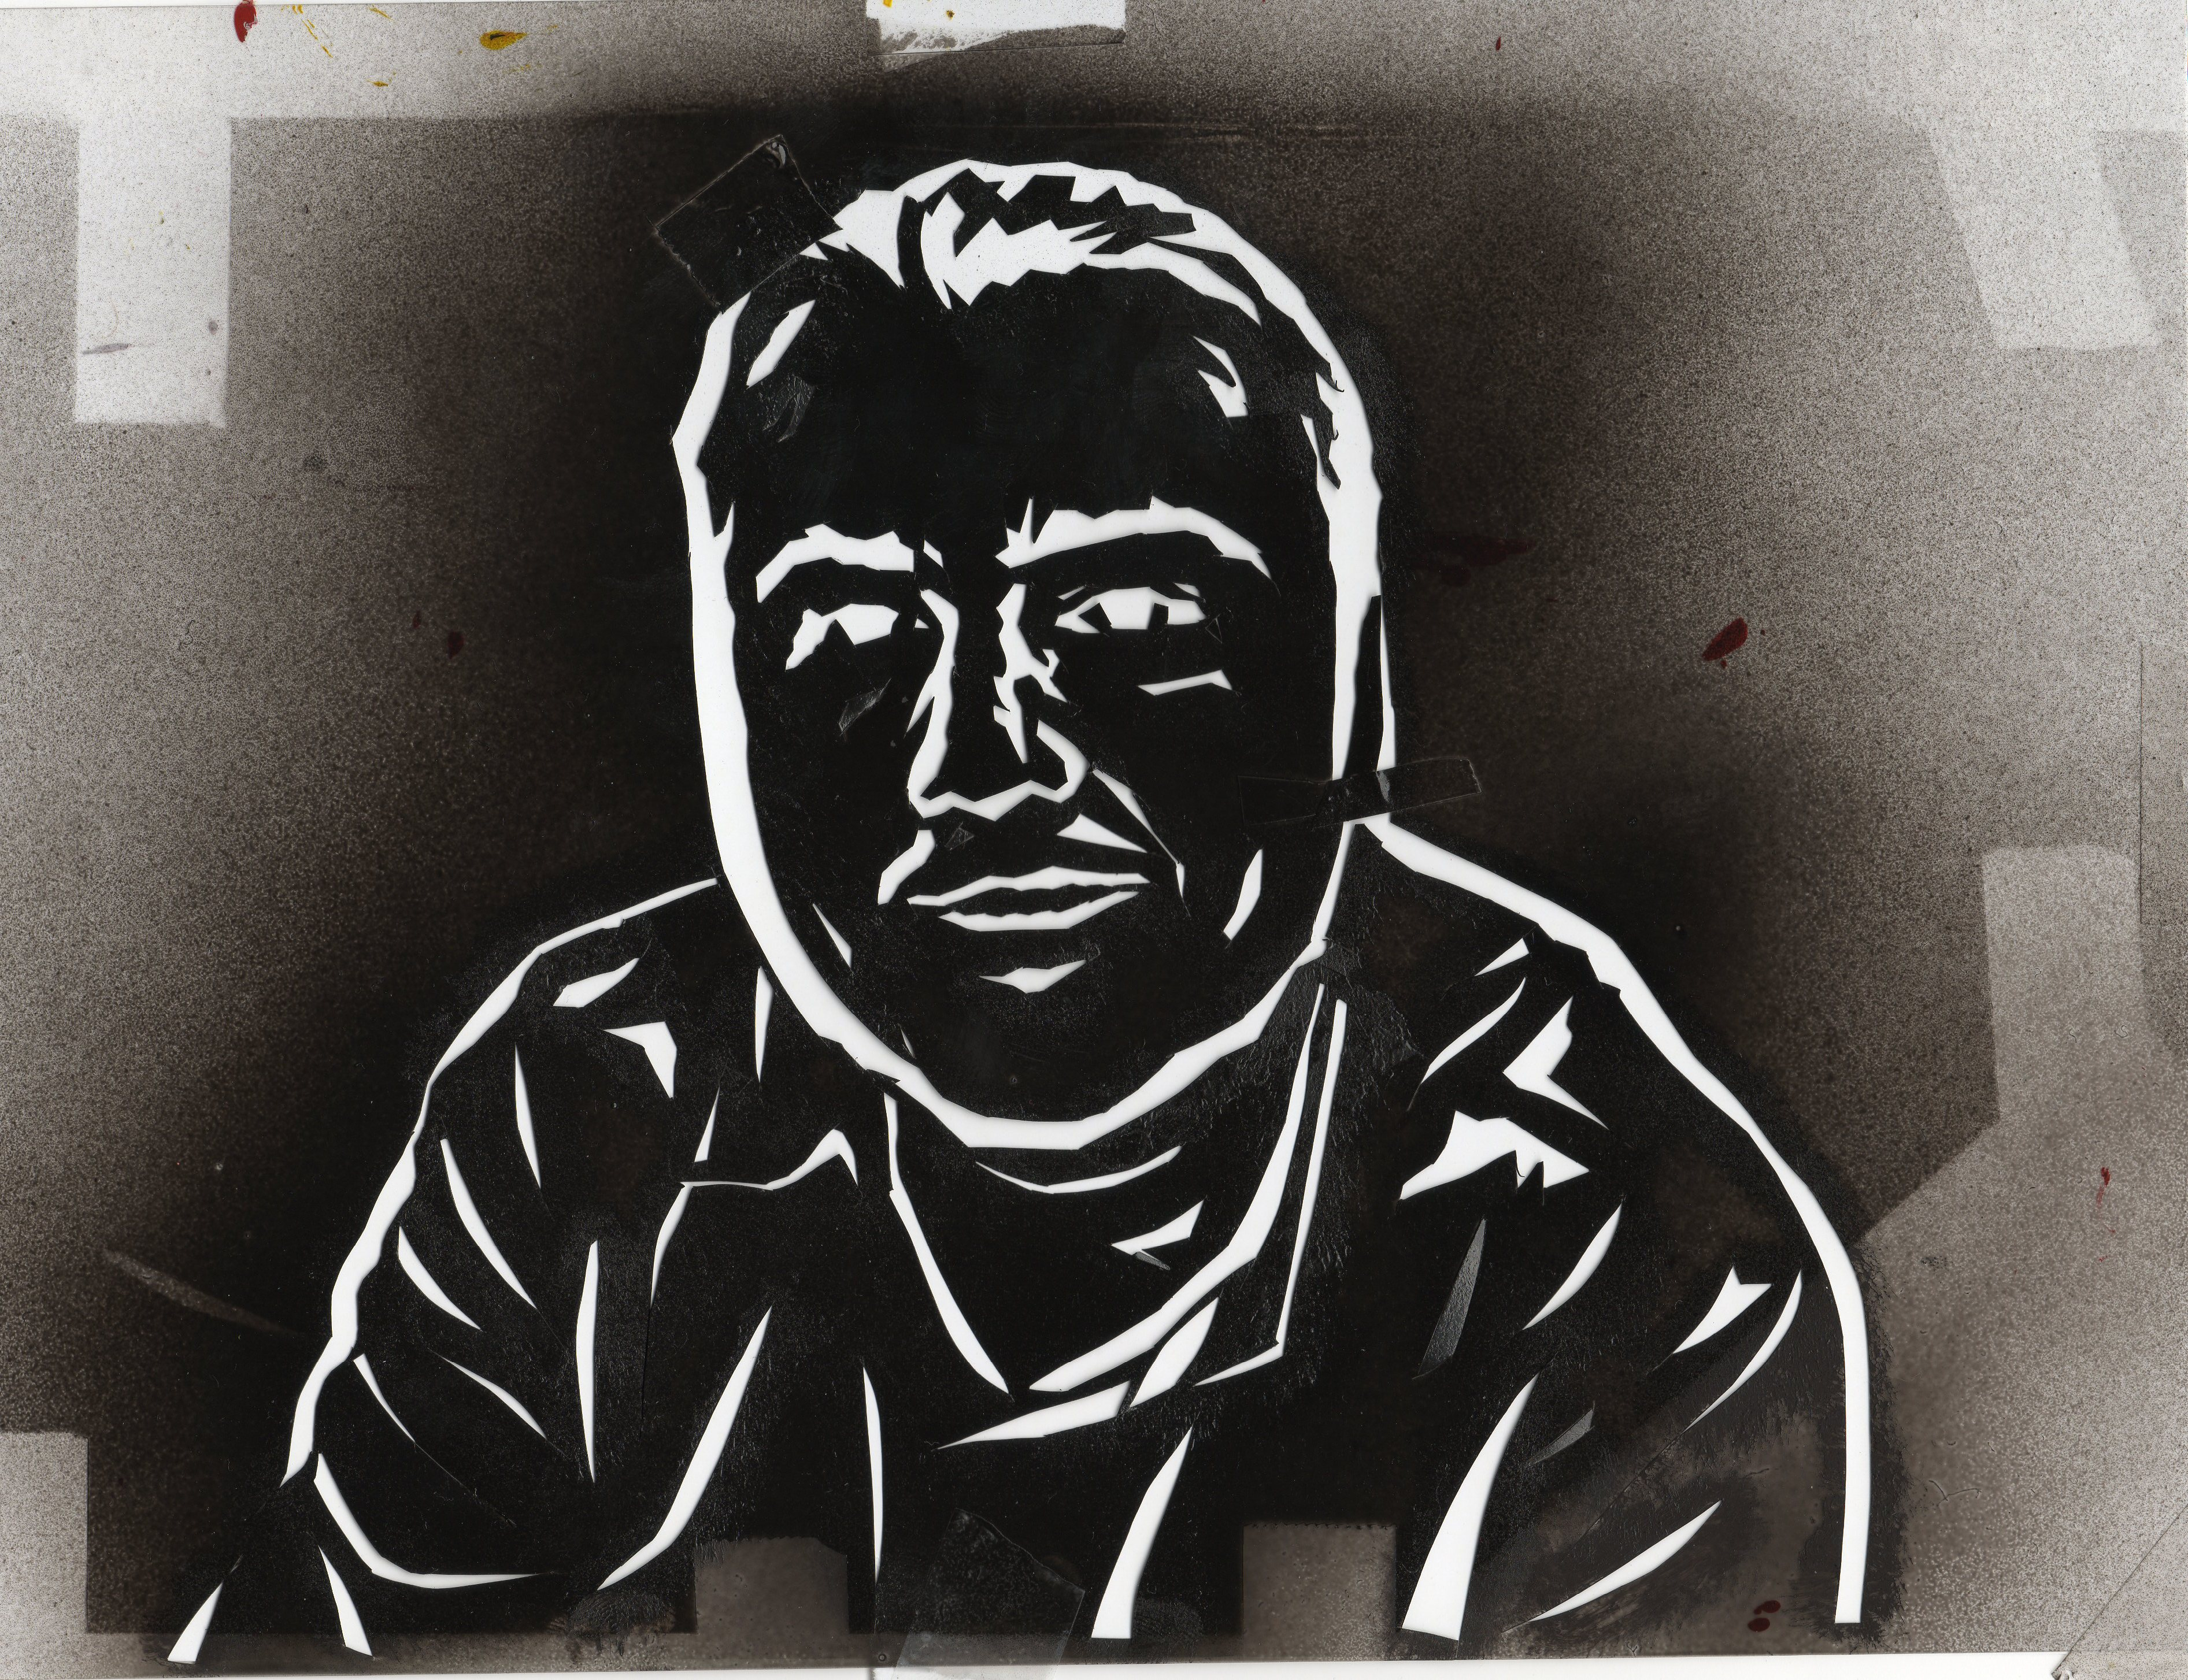
Your BANKSY portrait
You need to scan a picture of YOU into the computer then change it on photoshop to “Photocopy” once printed off you will use acetate and a craft knife to create a stencil

