Slide 1
Year 1 phonics meeting
Wednesday 7th February 2024

Slide 2
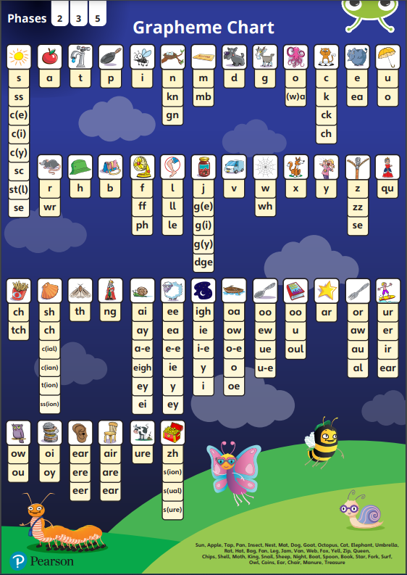


Slide 3
Year 1 Phonics Screening Test
Week beginning: Monday 10th June 2024
1:1 with Miss Simpson/Mrs Kane
40 words to read - 20 real words and 20 nonsense or ‘alien’ words
Pass mark is released at the end of June (previously 32/40)

Slide 4
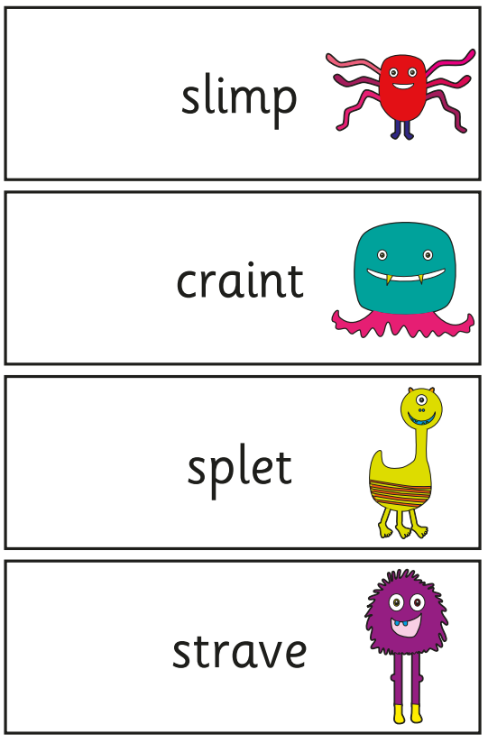
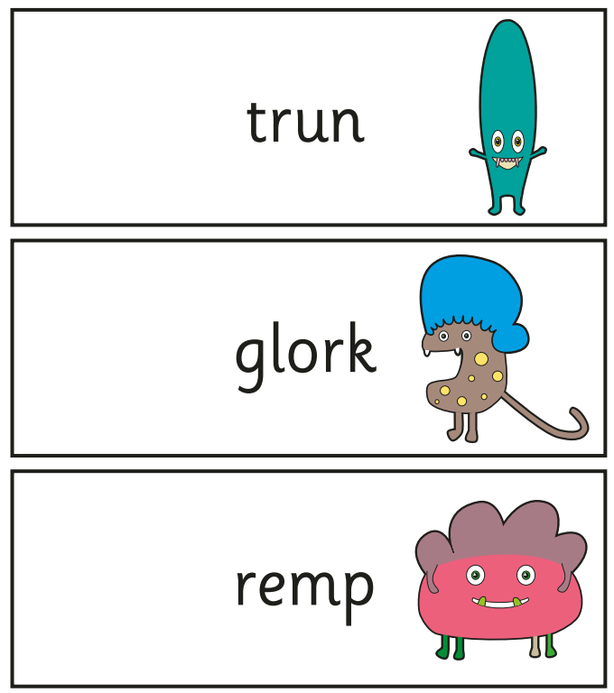
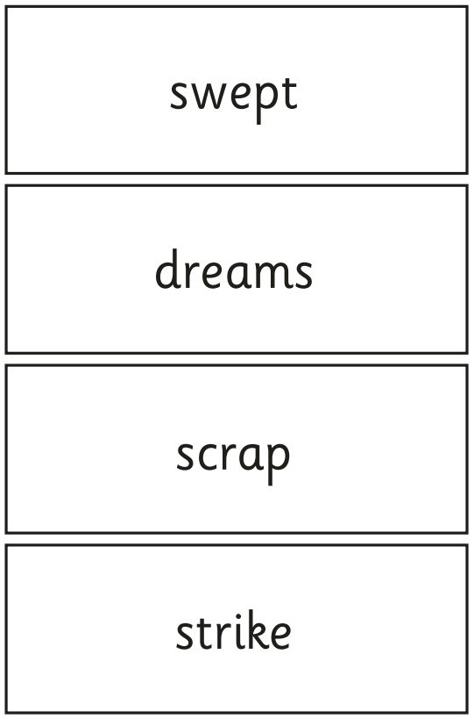
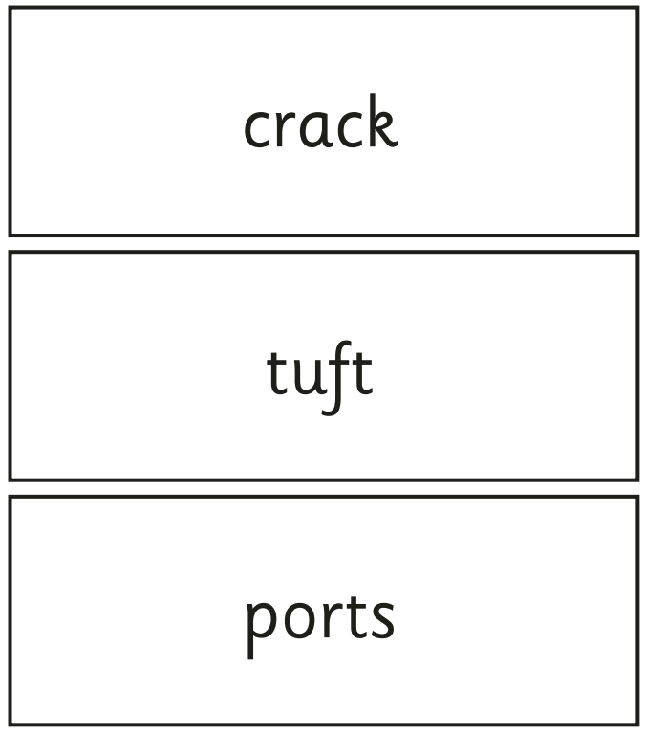

Slide 5
Year 1 Phonics Screening Test
Results will be shared with parents with the Summer term reports
If your child does not pass the screening check, they will receive phonics intervention in Year 2 and retake the screening check at the end of Year 2.

Slide 6
Dots and dashes
Dots for sounds made by 1 letter
Dashes for sounds made by 2 or more letters
Smiles for split digraphs
sat light cake

Slide 7
How can you help?
Point to different sounds on the sound mats randomly – take it in turns
Supporting your child to complete their homework
Playing phonics games (e.g. phonics play, Teach Your Monster to Read)
Bug Club online games
Reading as much as possible

