Slide 1

Welcome to Year 2!

Slide 2

Staff in Year 2
Miss Chazot
Mrs Gamsby
Mrs Kane (for phonics)

Slide 3


All about me
I studied Zoology at Durham University, before completing my PGCE.
I worked at Ox Close Primary, before moving to King Street.
This is my 7th year at King Street.
I have taught Year 4, Nursery and Year 5, whilst at King Street and taught Year 6 in the past.
I am the school’s Science Lead and Music Lead.
I especially enjoy teaching history, science and reading.
In my spare time, I enjoy baking and performing in amateur dramatics productions. I’m especially looking forward to directing the KS1 Christmas nativity again this year!

Slide 4
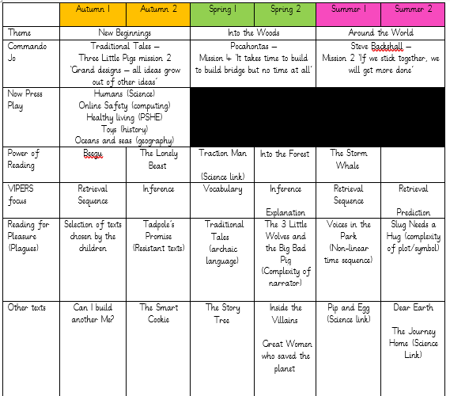
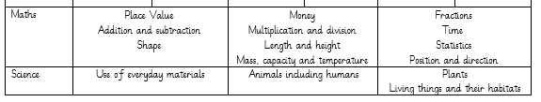
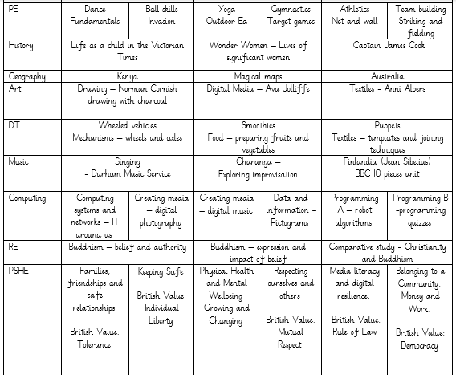
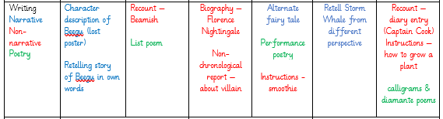
Our Learning

Slide 5
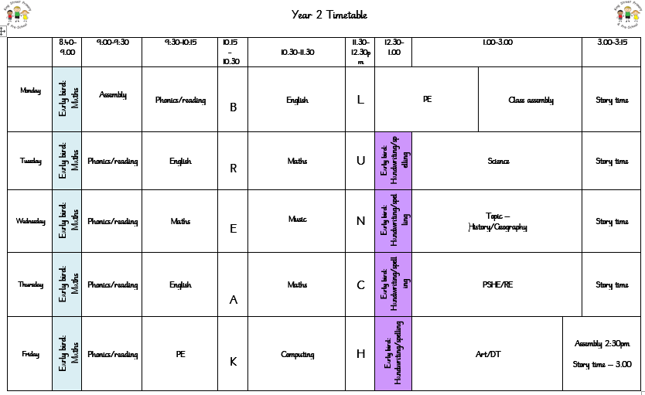
Our weekly timetable

Slide 6

PE
During the autumn term, we will have PE lessons twice a week, usually on Monday afternoons and Friday mornings.
PE kits, comprising of either a white or house coloured t-shirt, black shorts/leggings/jogging bottoms and sensible trainers must be present from Monday each week and will be sent home for cleaning each Friday. As PE lessons may be outdoors, please ensure your child has warm, weather-appropriate PE kit. Any ear piercings must be removed or covered on PE days. As staff are not permitted to help children do so, please ensure earrings are removed at home, before school on these days.
Our first PE topics will be dance and fundamental skills.

Slide 7
Our daily routine
Our Year 2 children enter school via the main yard door, from 8.30am. If you have any messages, I will be available outside this door between 8.30 and 8.45am, when the door is locked. At the end of the school day, pupils will leave via the same door at 3.15pm, accompanied by the Year 2 staff. Please wait in the Main Yard, where we will ensure your child can see you and we will pass on any messages from the day.
The register will be taken at 8.45am, however, I’d like to take this opportunity to emphasise the importance of children arriving at our flexible arrival time from 8.30am, as much vital learning takes part during our Early Bird sessions. After registration, we like to have a bit of a dance to wake ourselves up, before our daily phonics session. After this, all children will discover the maths and English focus of the day. Children will usually work in small groups to complete tasks, with adult support, where needed.
Whilst not completing a focused task, children will have the freedom to choose activities in the classroom environment; we believe that it is so important to continue ‘continuous provision’ all the way through Key Stage 1 and have areas such as: blocks, construction, independent writing and reading, in order for every child to feel valued and successful.

Slide 8

Expectations of Behaviour & Gem Powers
We have high expectations of our children, encouraging kindness, focus and self-regulation.
Visitors and members of the public always comment on the excellent behaviour of the children!
We encourage this through our Gem Powers:
Being kind
Being responsible
Being resilient
Co-operating
Collaborating
Focusing

Slide 9

Golden rules and rewards
Year 2 have created their own list of ‘Golden Rules’, based on the Gem Powers.
If you follow all of the Golden Rules, you have a chance of winning ‘Star of the Day’ and receiving a sticker, prize and the chance to wear the ‘Bright Idea Hat’!

Slide 10



Topic-based learning
At King Street, we teach our curriculum through topics and themes.
Our autumn term topic will be ‘New Beginnings’. We are all very excited about this topic and hope that by focusing on texts which feature characters in new situations, this will help the children settle into their new year group and surroundings. We will be reading a variety of books, including: Beegu, the Lonely Beast and Can I Build Another Me? By delving into these stories in detail and exploring them through discussion and roleplay, the children will gain a deeper understanding and appreciation for reading, which will help them to become informed and enthusiastic writers. We will continue to learn our phonics, before moving onto spelling.

Slide 11
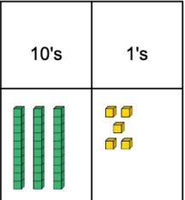

In Maths, we will be focusing on place value, addition & subtraction and shape. Maths learning will take place through whole class teaching, adult-led focused tasks and child-led discovery using freely accessible resources in our maths area.
Our first Science topic is ‘Uses of Everyday Materials’, where we will be: identifying and comparing the suitability of a variety of everyday materials, including wood, metal, plastic, glass, brick, rock, paper and cardboard for particular uses, and finding out how the shapes of solid objects made from some materials can be changed by squashing, bending, twisting and stretching.

Slide 12
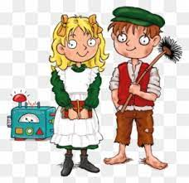
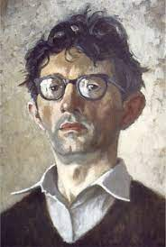



In History, we will be asking and answering questions about the past and discovering what life was like for children in Victorian Britain – and how it compares to today!
In Geography, we will be learning all about Kenya.
In Art, we will learn about the works of Norman Cornish and create our own charcoal portraits and in DT we will investigate and build our own wheeled vehicles.
In computing we will be learning how to stay safe when using IT and in RE, we will begin our lessons on Buddhism.
Our PSHE topic is ‘Families, friendships and safe relationships’, where we will be learning to recognise healthy relationships and have a basic understanding of ‘consent’.

Slide 13

Home Learning
Every Monday, children will be given a spelling task and a maths task, using a mixture of paper and online resources. These must be completed by that Friday. If you are unable to access online resources or are unsure of your child’s login details, please let me know. The tasks will initially aim to recap key skills, such as phonics and number bonds.
Children will continue to have a school reading book to read at home and will change their books once a week, on a set day. It is vital, that children read during the week, and it is expected that an adult’s signature/comment will be evident a minimum of three days per week. These will be checked regularly by staff; therefore, children must have their reading book and record every day. Children will read with an adult in school throughout the week, and where the need is identified, additional reading/phonics intervention will be planned into our daily timetable. Those children who did not pass the Year 1 Phonics Screening will be supported throughout this year to re-sit the assessment in June 2024.
Reading

Slide 14
Helping At Home
Regular reading and phonics – at least 3 times per week.
Counting forwards and backwards within 100
Times tables – 2s, 5s and 10s
Letter and number formation
Telling the time
Recognising and using money
Cooking & baking (using measurements)
Get outdoors
Sleep!

Slide 15


Uniform
Children should come to school in the appropriate uniform. This consists of: black or grey trousers/shorts/skirt/pinafore; a white polo shirt; a blue cardigan/sweatshirt; and plain black shoes. We have thought carefully about how to keep our uniform costs manageable for families, but if there are any difficulties with providing uniform, please do let us know as we can support with this.
Please ensure all items of clothing (including shoes and wellies) are clearly labelled as we have so many children wearing the same or similar clothing and it is easy to get muddled. Being labelled will ensure that it will find its way back to you!
We will also be uploading regular updates to our school Facebook page. If you haven’t joined yet, just search for ‘King Street Primary School – The Home of Active Ted’. We will ensure that we have photographic permission before uploading any photos of the children.
Facebook

Slide 16
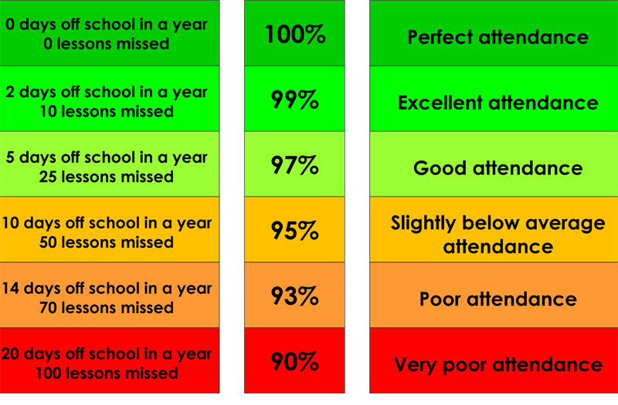
Attendance & Lateness
Every single day a child is absent = one day of learning lost
Being at school on time (Early Bird starts at 8.30am) allows your child to feel settled and prepared for their day.

Slide 17
Contact Information
Teachers are available each morning on the school yard for any concerns or questions.
If you would prefer to make an appointment, you can do so through the school office.
Teachers can also be contacted directly via email. Please be aware, as a school we support a healthy work-life balance and do not expect staff to respond outside of working hours so do be mindful of this!
i.chazot300@kingstreet.durham.sch.uk
j.kane103@kingstreet.durham.sch.uk
n.livesley300@kingstreet.durham.sch.uk

Slide 18

Thank you for listening!
We can’t wait to make more memories over the next academic year.
If you have any questions, please don’t hesitate to ask!

