Slide 1
Welcome to year 4
Miss Bell, Mrs Bott & Miss Navin

Slide 2
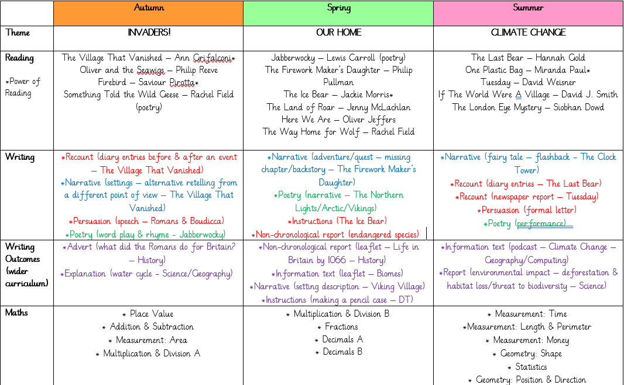
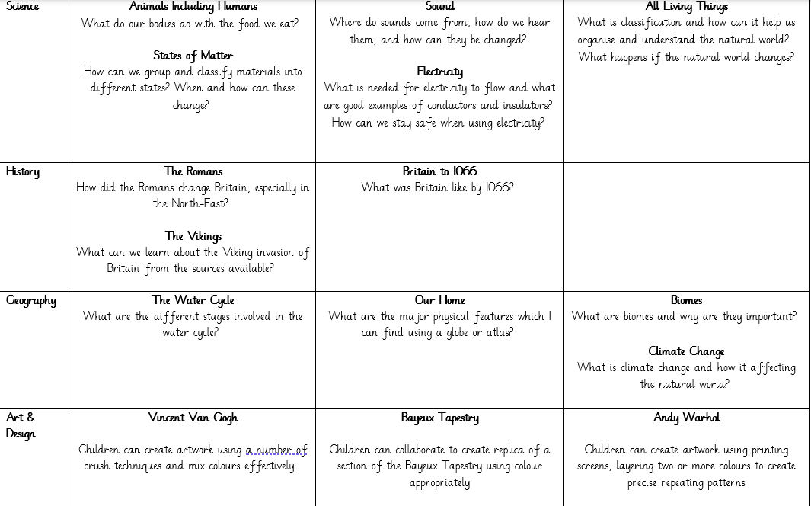
Our Learning

Slide 3
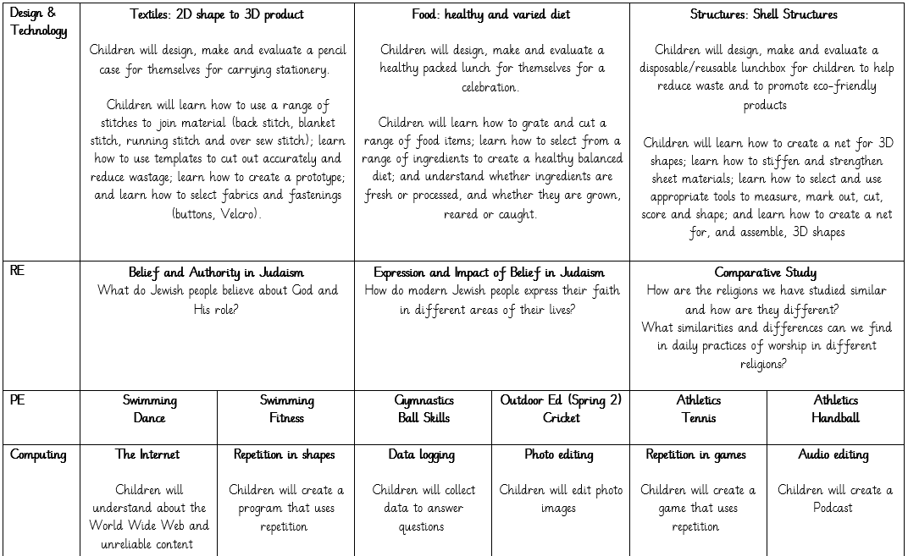
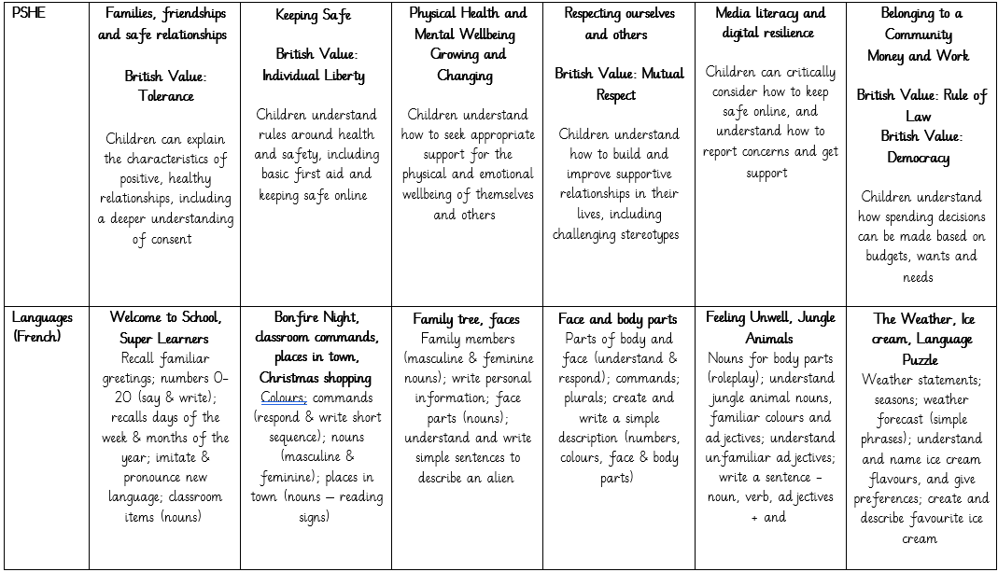
Our Learning

Slide 4
Uniform & PE kit
PE
Our PE lessons will usually take place on Fridays; please send PE kits in to school with your child on a Monday, and these will be sent home on Fridays. PE kit should consist of: tracksuit bottoms, trainers and a change of top (preferably a school t-shirt in house colours or plain white t-shirt), as well as a sweatshirt for the outdoors.
Uniform
Children should all come to school wearing: black or grey trousers/shorts/skirt/pinafore; a white polo shirt; a blue cardigan/sweatshirt; and plain black shoes. We have thought carefully about how to keep our uniform costs manageable for families, but if there are any difficulties with providing uniform, please do let us know as we can support with this.
Free uniform is available from our Community Hub – check the newsletter for further details.

Slide 5
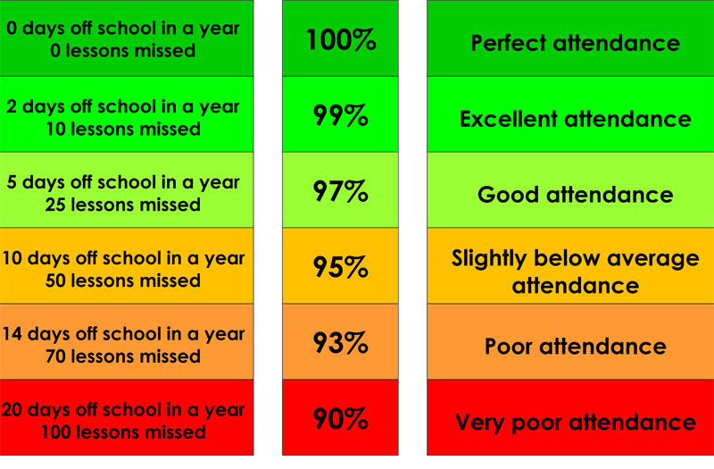
Attendance & Lateness
Every single day a child is absent = one day of learning lost
Being at school on time (school opens at 8.30am) allows your child to feel settled and prepared for their day.

Slide 6
Home Learning
Homework will be set through the online platform ‘EdShed’. This will always be set on a Monday and to be completed by Friday.
Times tables: there are lots of games available, with links to some good examples available on our class website page.
Other homework tasks and projects may be set over the term linked to our current areas of learning.

Slide 7

Reading
We are passionate about reading in school, and believe that it is the single most important skill to give your child. It opens up the whole world to them!
Please support by hearing your child read at least three times a week, and letting us know if you have any concerns.
By Year 4, we would expect the majority of children to read fluently, with the focus at home being on vocabulary and comprehension.

Slide 8
Helping At Home
Regular reading
Times tables
Telling the time
Cooking & baking
Get outdoors
Sleep!

Slide 9
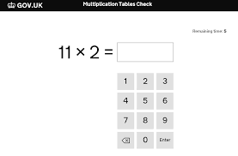
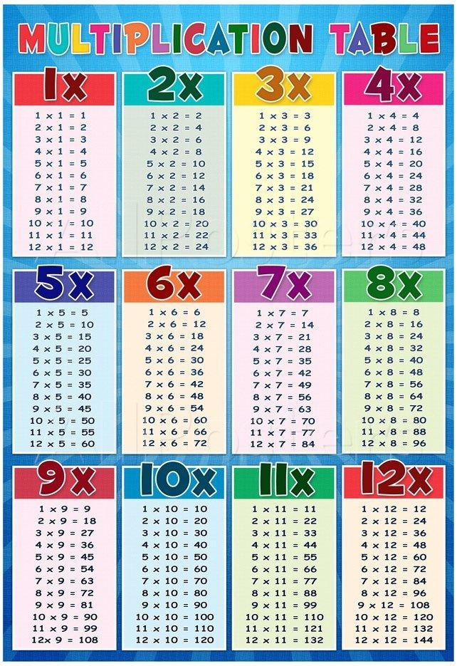
Year 4 Multiplication Check
This takes place in June.
The children answer a series of multiplication questions, testing them on their recall of facts up to 12x12.
They only have 6 seconds to answer!
We will do lots of work on our times tables this year, but please support us at home with lots of regular practice – there are lots of websites to help.
Your child’s eSchools classroom has lots of resources to support (Projects > Year 4 Multiplication Check).

Slide 10

Expectations of Behaviour & Gem Powers
We have high expectations of our children, encouraging kindness, focus and self-regulation.
Visitors and members of the public always comment on the excellent behaviour of the children!
We encourage this through our Gem Powers:
Being kind
Being responsible
Being resilient
Co-operating
Collaborating
Focusing

Slide 11
Contact Information
Teachers are available each morning on the school yard for any concerns or questions.
If you would prefer to make an appointment, you can do so through the school office.
Teachers can also be contacted directly via email. Please be aware, as a school we support a healthy work-life balance and do not expect staff to respond outside of working hours so do be mindful of this!
e.bell300@kingstreet.durham.sch.uk
j.nicholson103@kingstreet.durham.sch.uk
n.livesley@kingstreet.durham.sch.uk

