Slide 1

Welcome to our EYFS unit
Reception Induction Meeting

Slide 2
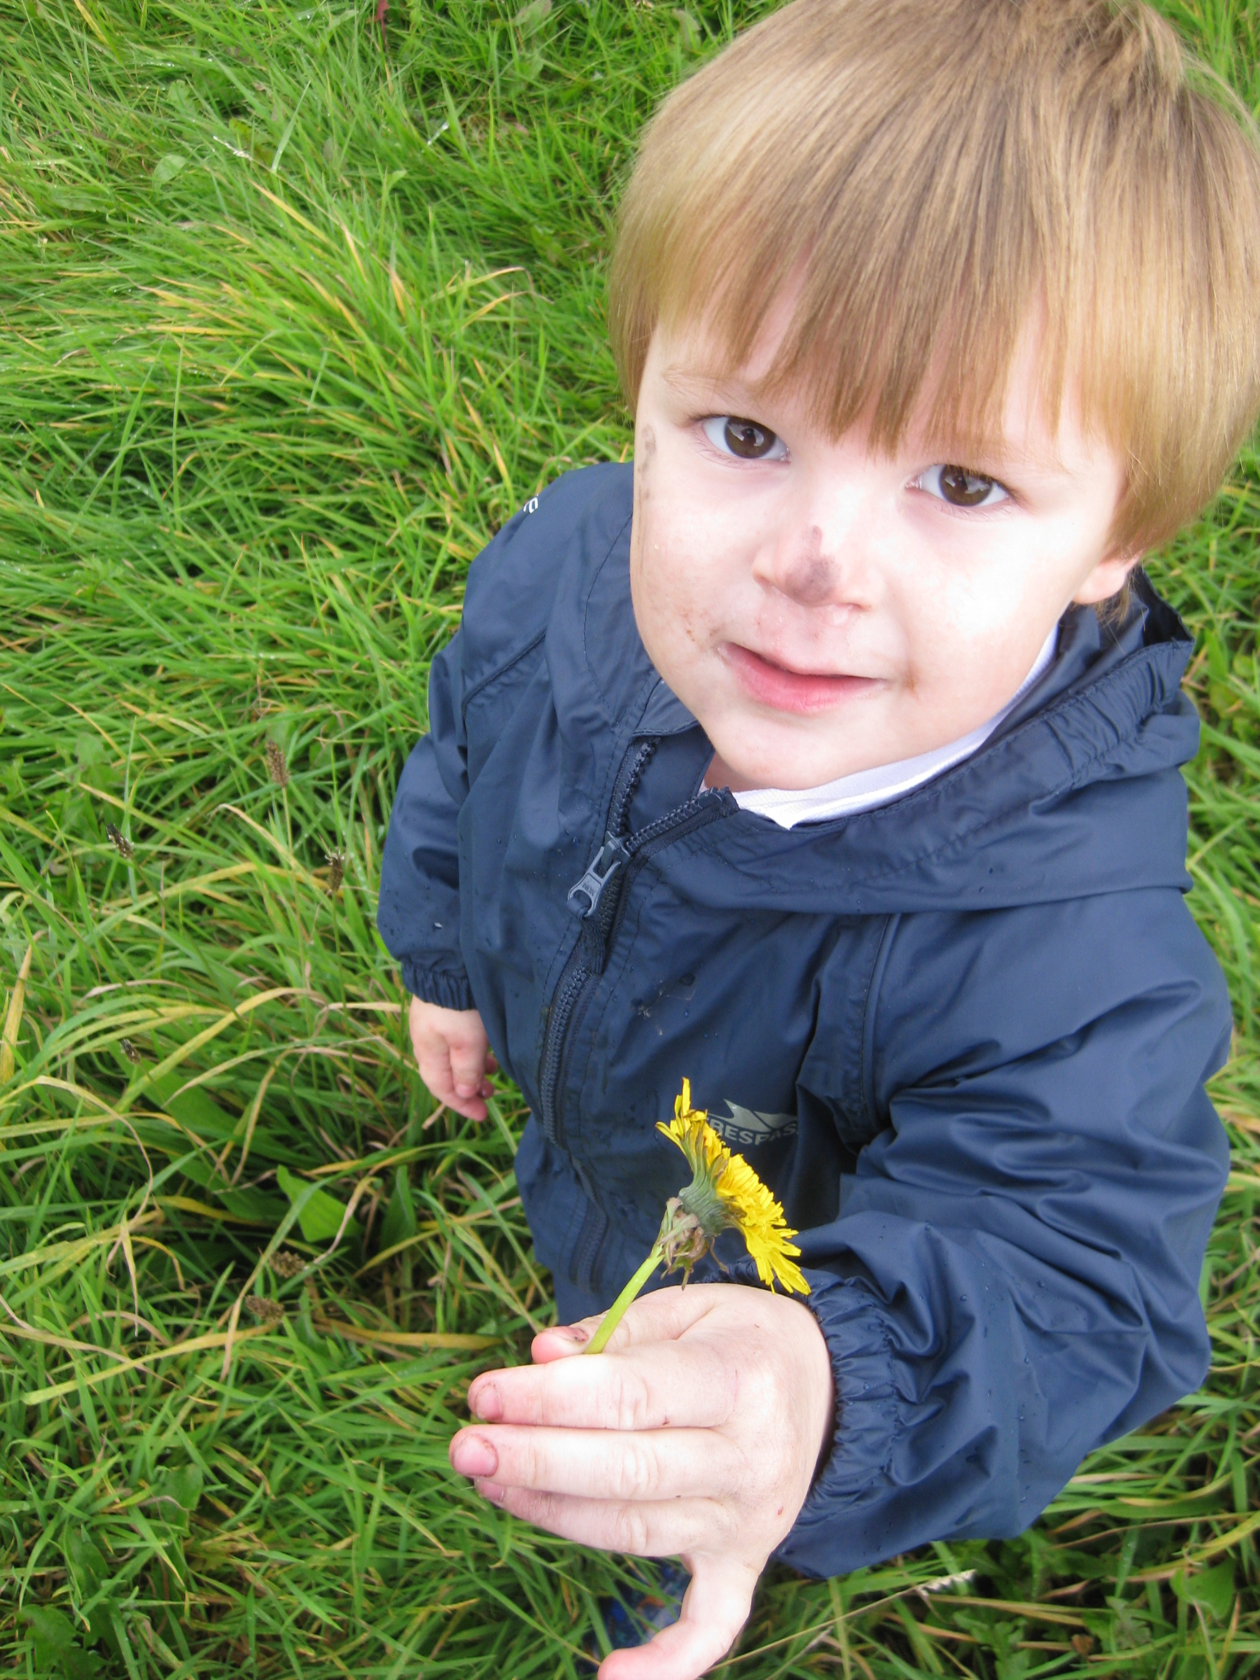
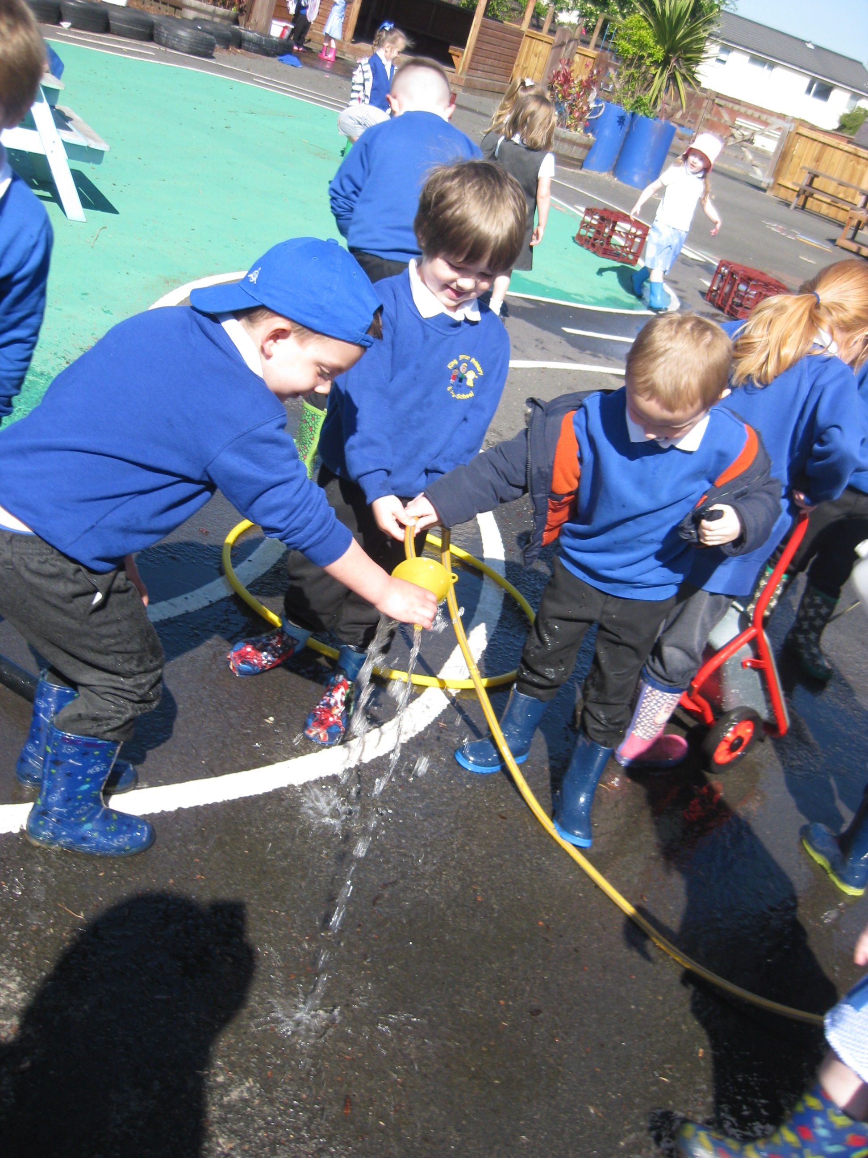
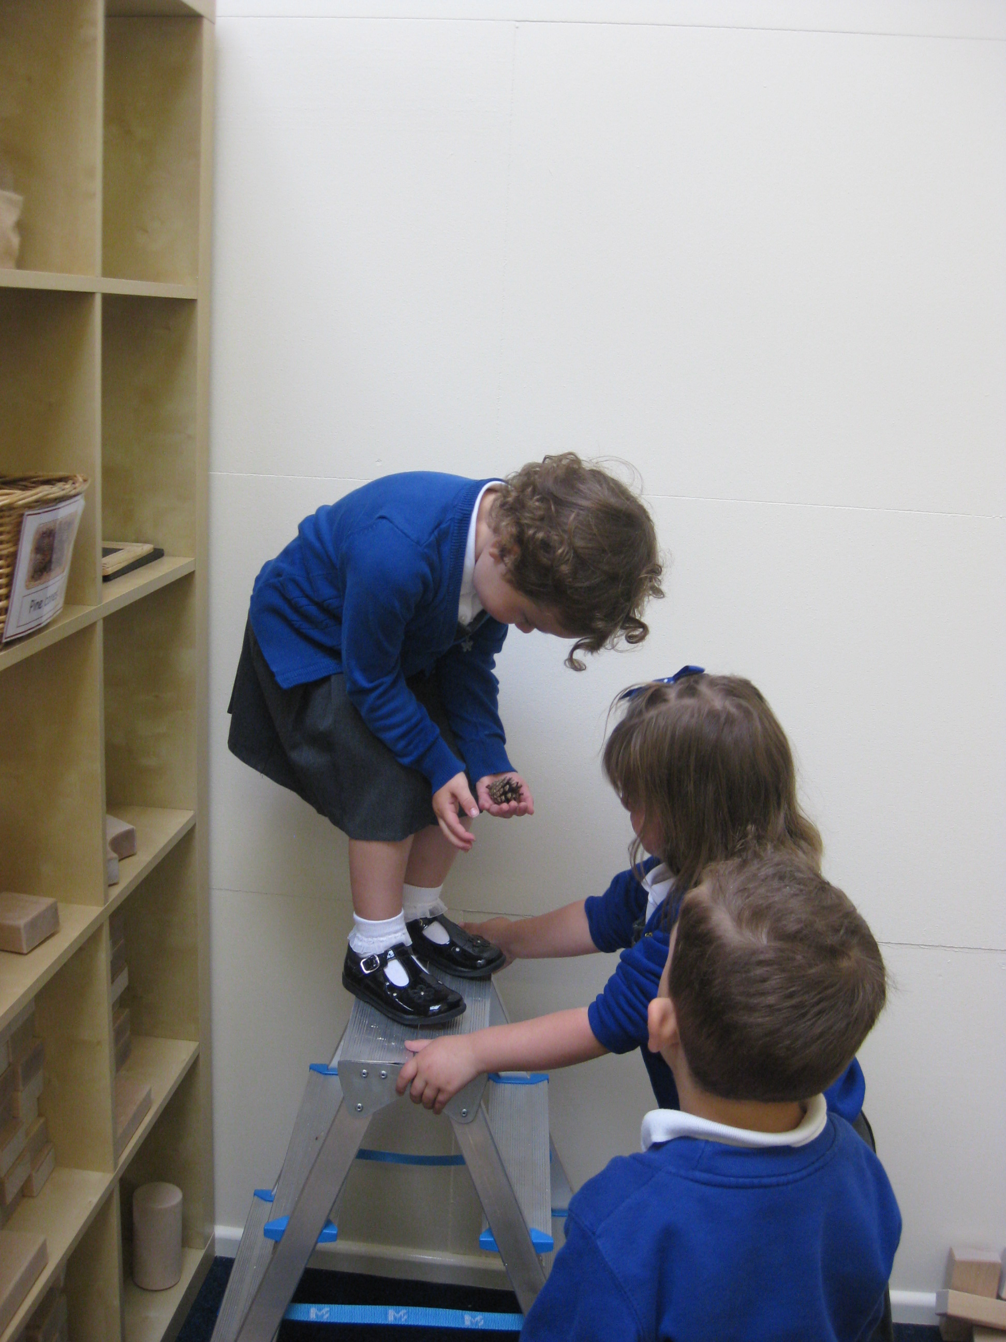
What is the Early Years Foundation Stage?
The Early Years Foundation Stage (E.Y.F.S.) is the stage of education for children from birth to the end of the Reception year.
It is based on the recognition that children learn best through play and active learning.

Slide 3
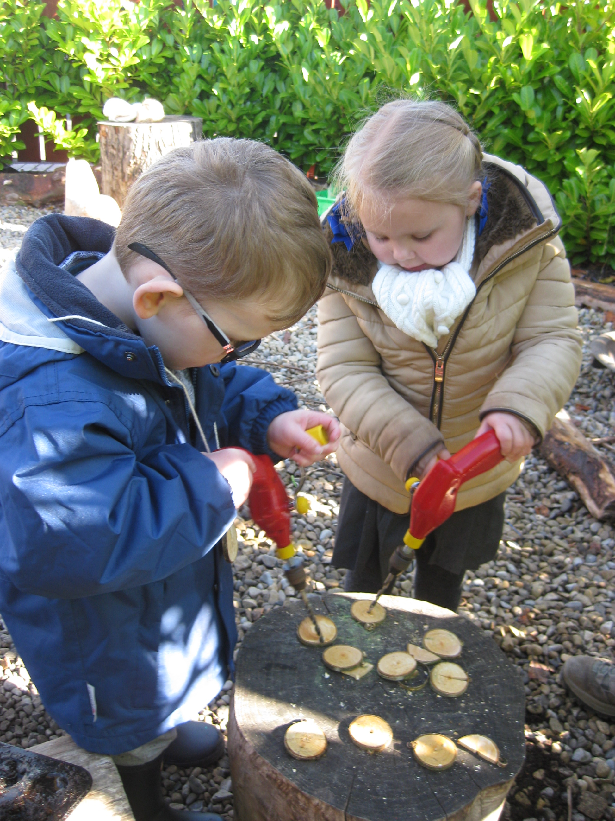
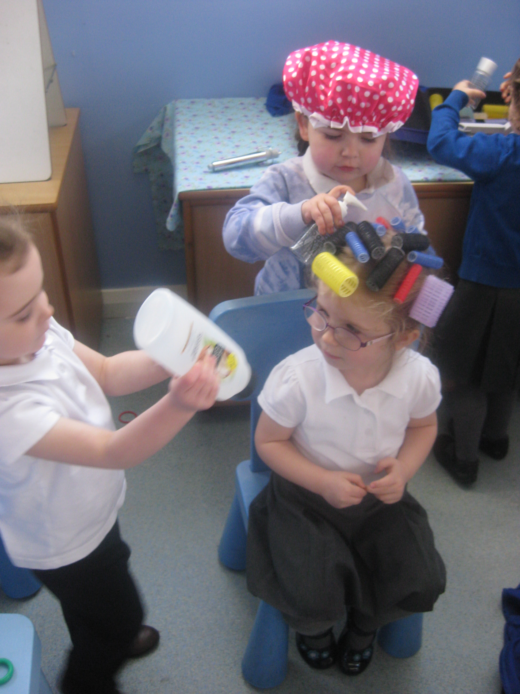
The E.Y.F.S. is based on 4 themes:
1 A Unique Child -Every child is a competent learner from birth who can be resilient, capable, confident and self-assured.
2 Positive Relationships -Children learn to be strong and independent from a base of loving and secure relationships with parents and/or a key person.
3 Enabling Environments - The environment plays a key role in supporting and extending children's development and learning.
4 Learning and Development - Children develop and learn in different ways and at different rates and all areas of Learning and Development are equally important and inter-connected.

Slide 4
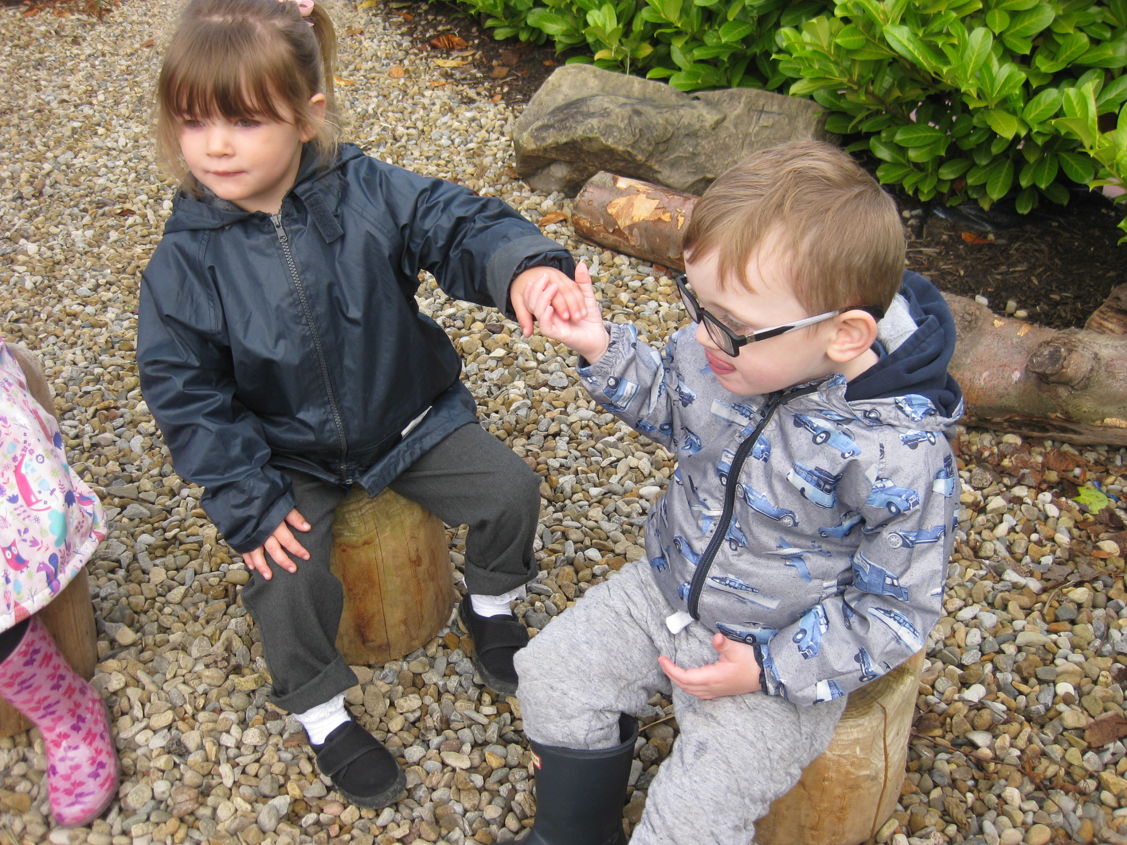
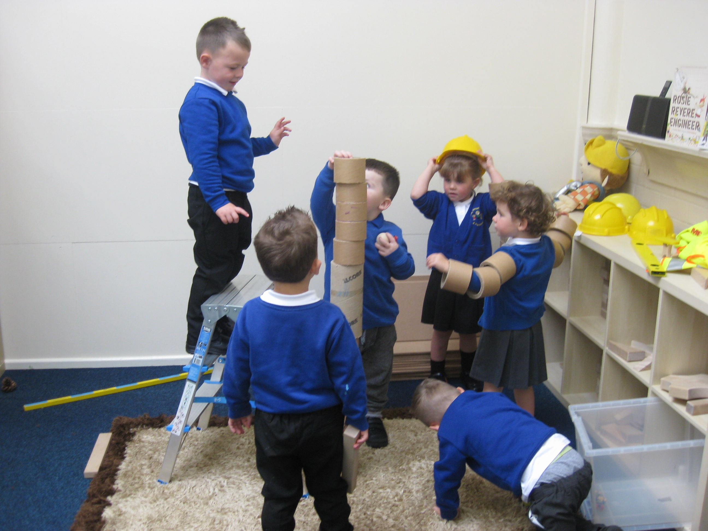
Within the theme of Learning and Development there are seven areas:
Personal, Social and Emotional Development
Communication & Language
Physical Development
4. Mathematics
5. Understanding the World
6. Literacy
7. Creative Development

Slide 5
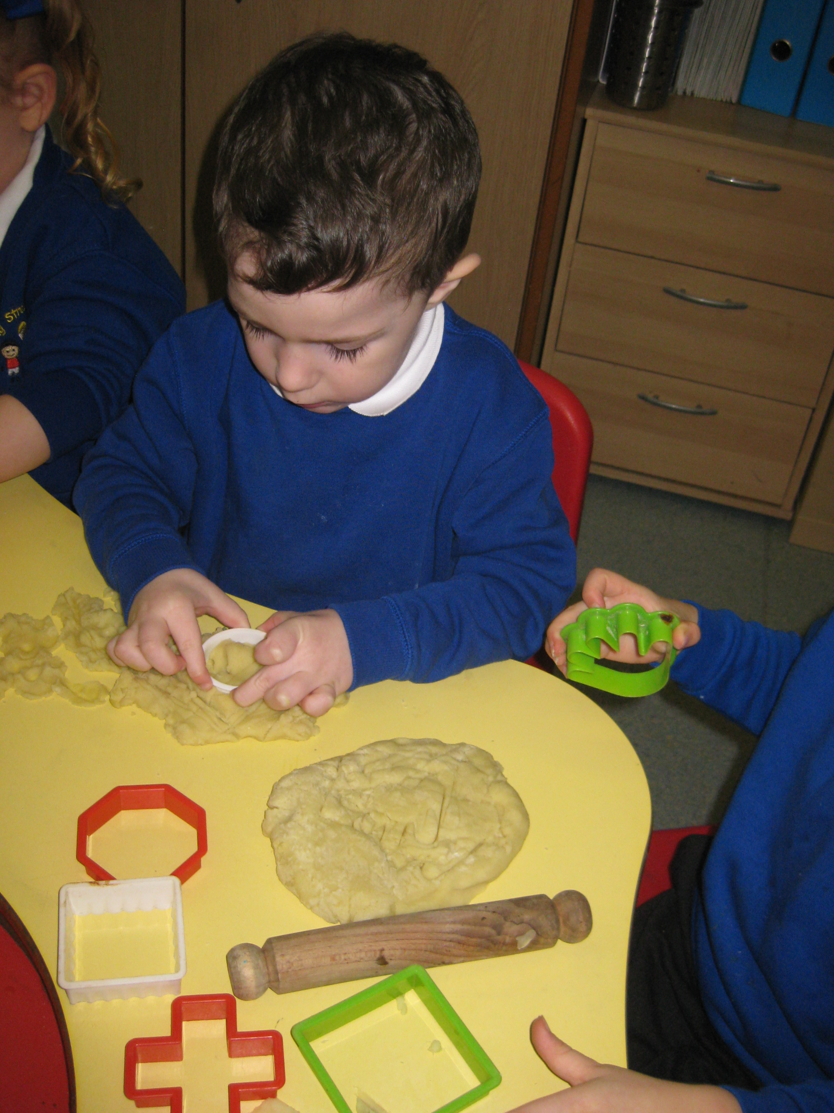
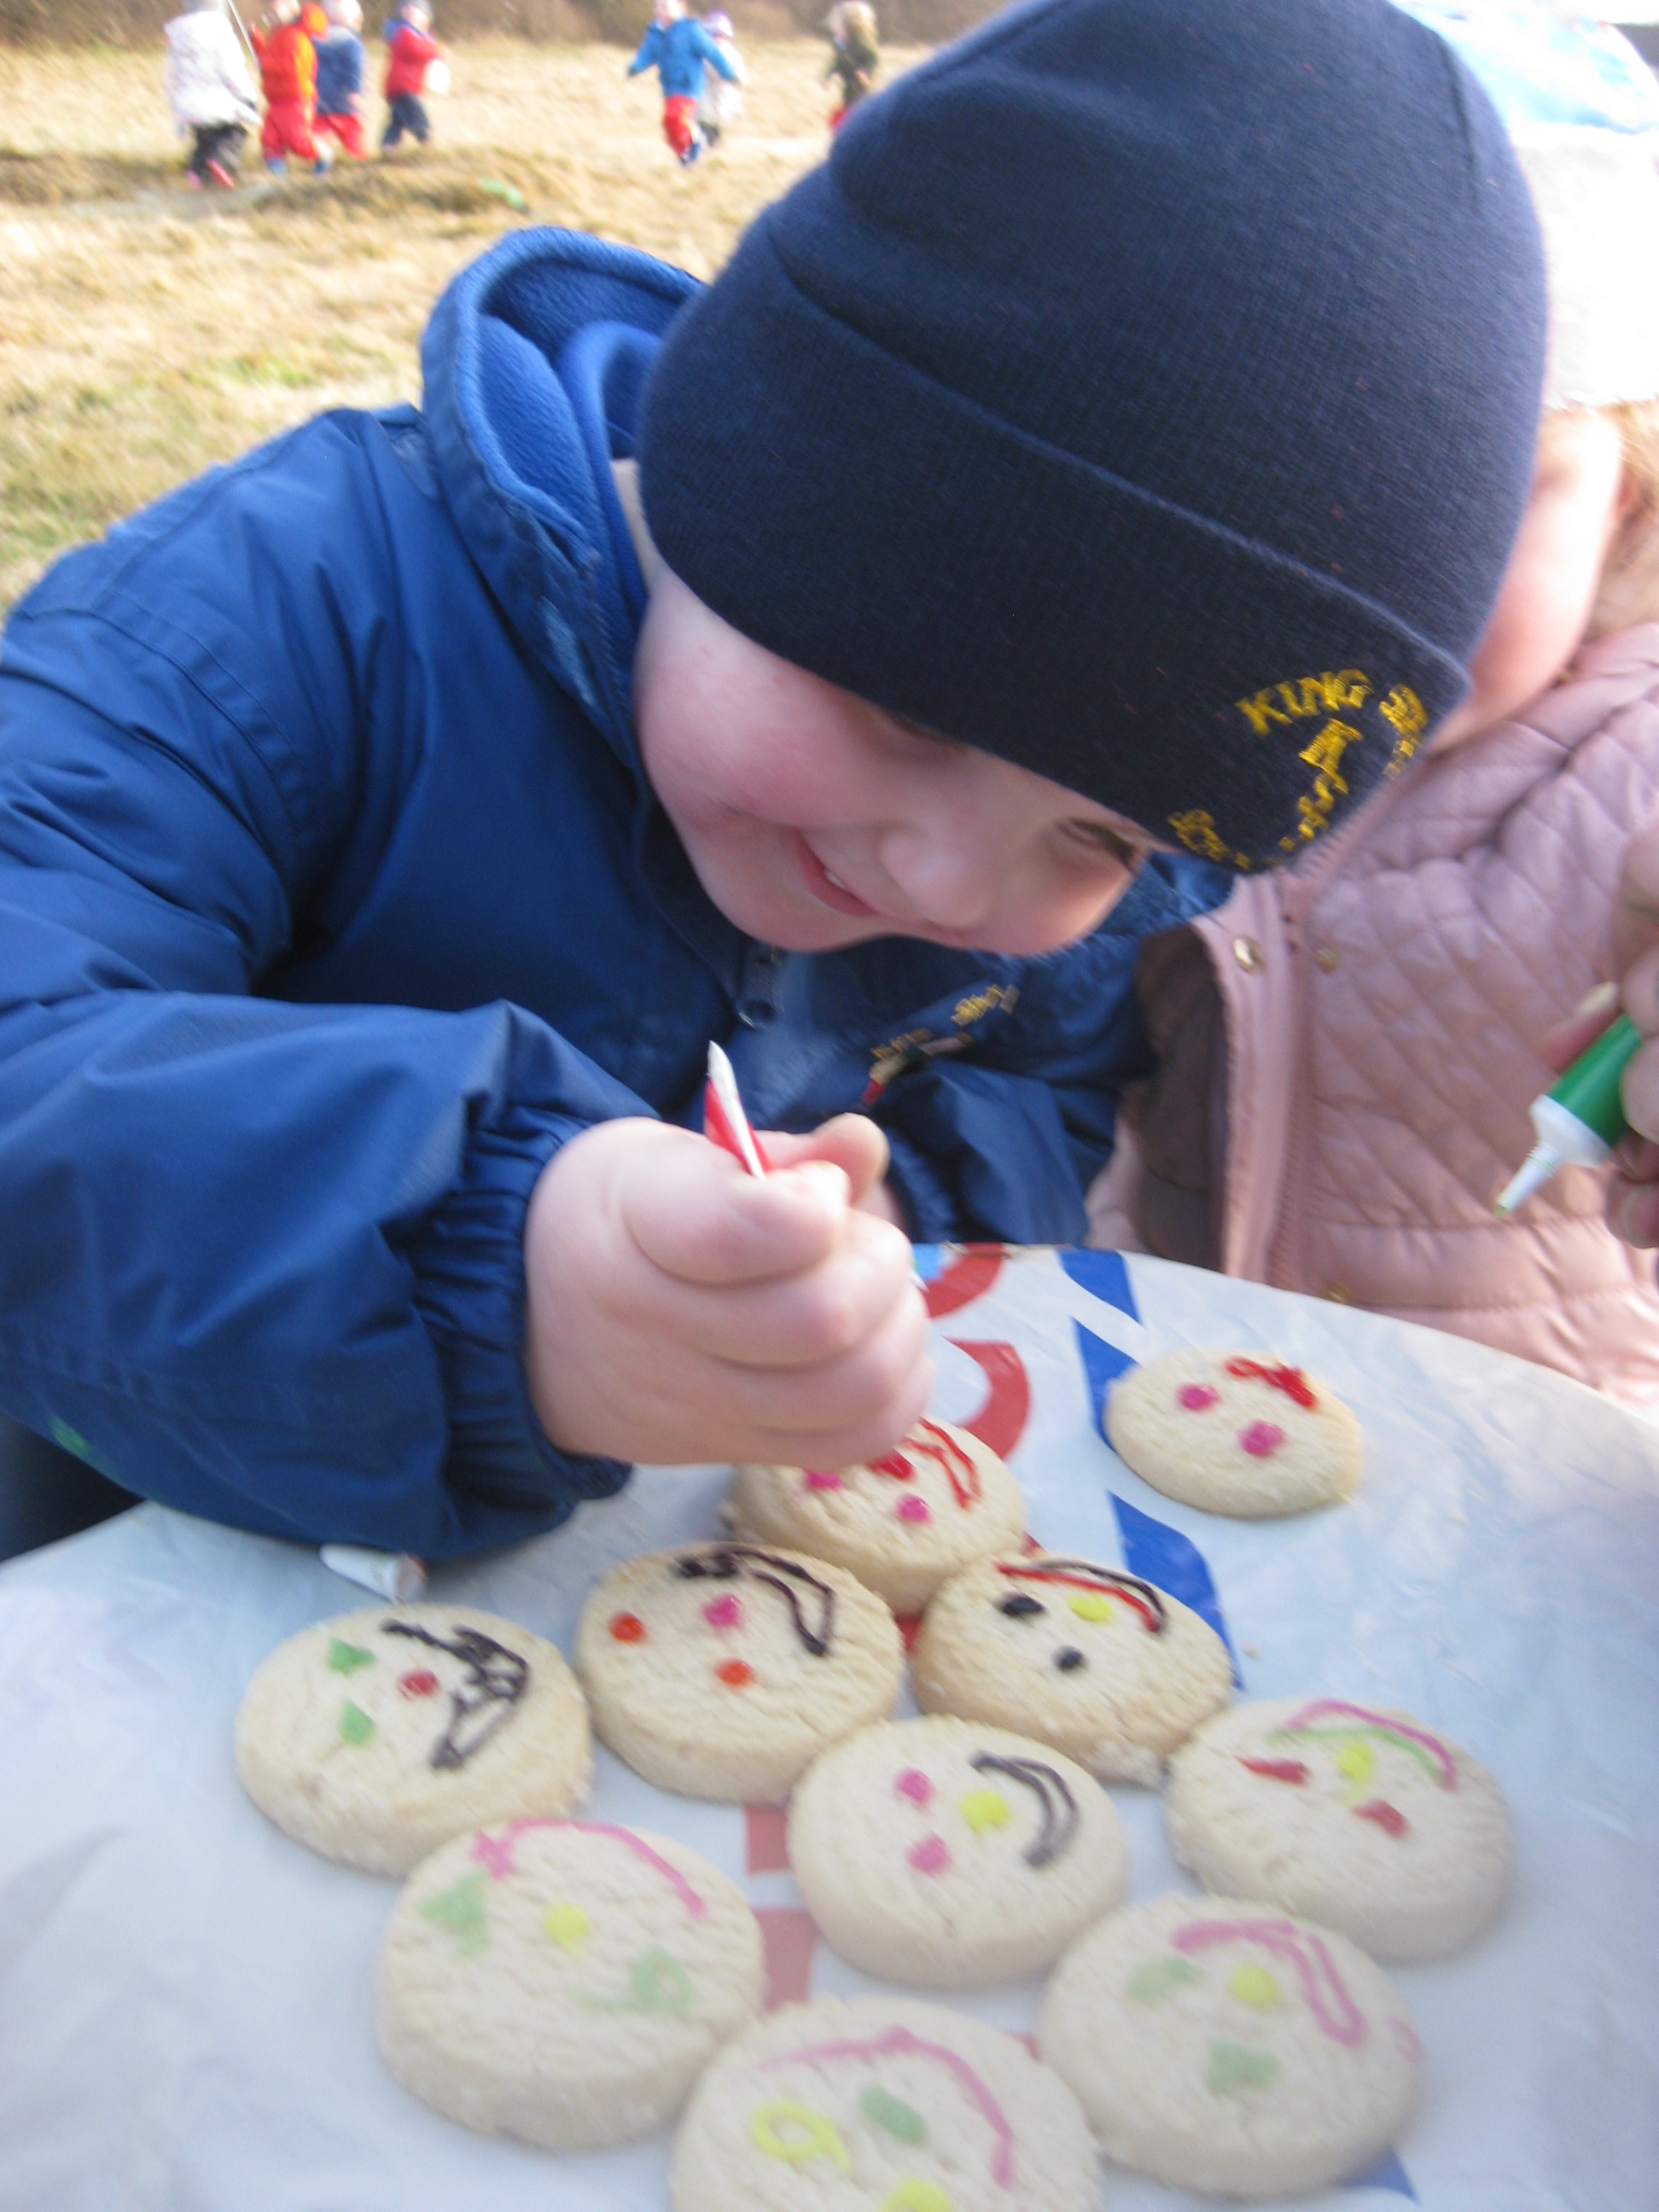
The characteristics of effective learning
The characteristics of effective learning are a key element in the EYFS. They detail the ways in which children should be learning from their environment, experiences and activities. Children up to the age of five should all be displaying the characteristics of effective learning every day.
Playing and exploring – engagement
Finding out and exploring
Playing with what they know
Being willing to ‘have a go’
Active learning – motivation
Being involved and concentrating
Keeping trying
Enjoying achieving what they set out to do
Creating and thinking critically – thinking
Having their own ideas
Making links
Choosing ways to do things

Slide 6
Our Staff
The Reception class teacher is responsible for planning the next steps of learning for children within the Reception class with the support of the Early Years Practitioners in the setting.
Your child will be allocated a Key Person who will get to know your little one within small ‘Family Group’ times. The Key Person is your first point of contact as a parent and is responsible for keeping your child’s journal up to date.
We have 5 full-time members of staff within our EYFS Unit who all support your children learning in a fun and meaningful way through their play.
Our Reception and Nursery aged children play and learn together throughout the setting. Children are challenged through quality interactions of our staff.

Slide 7
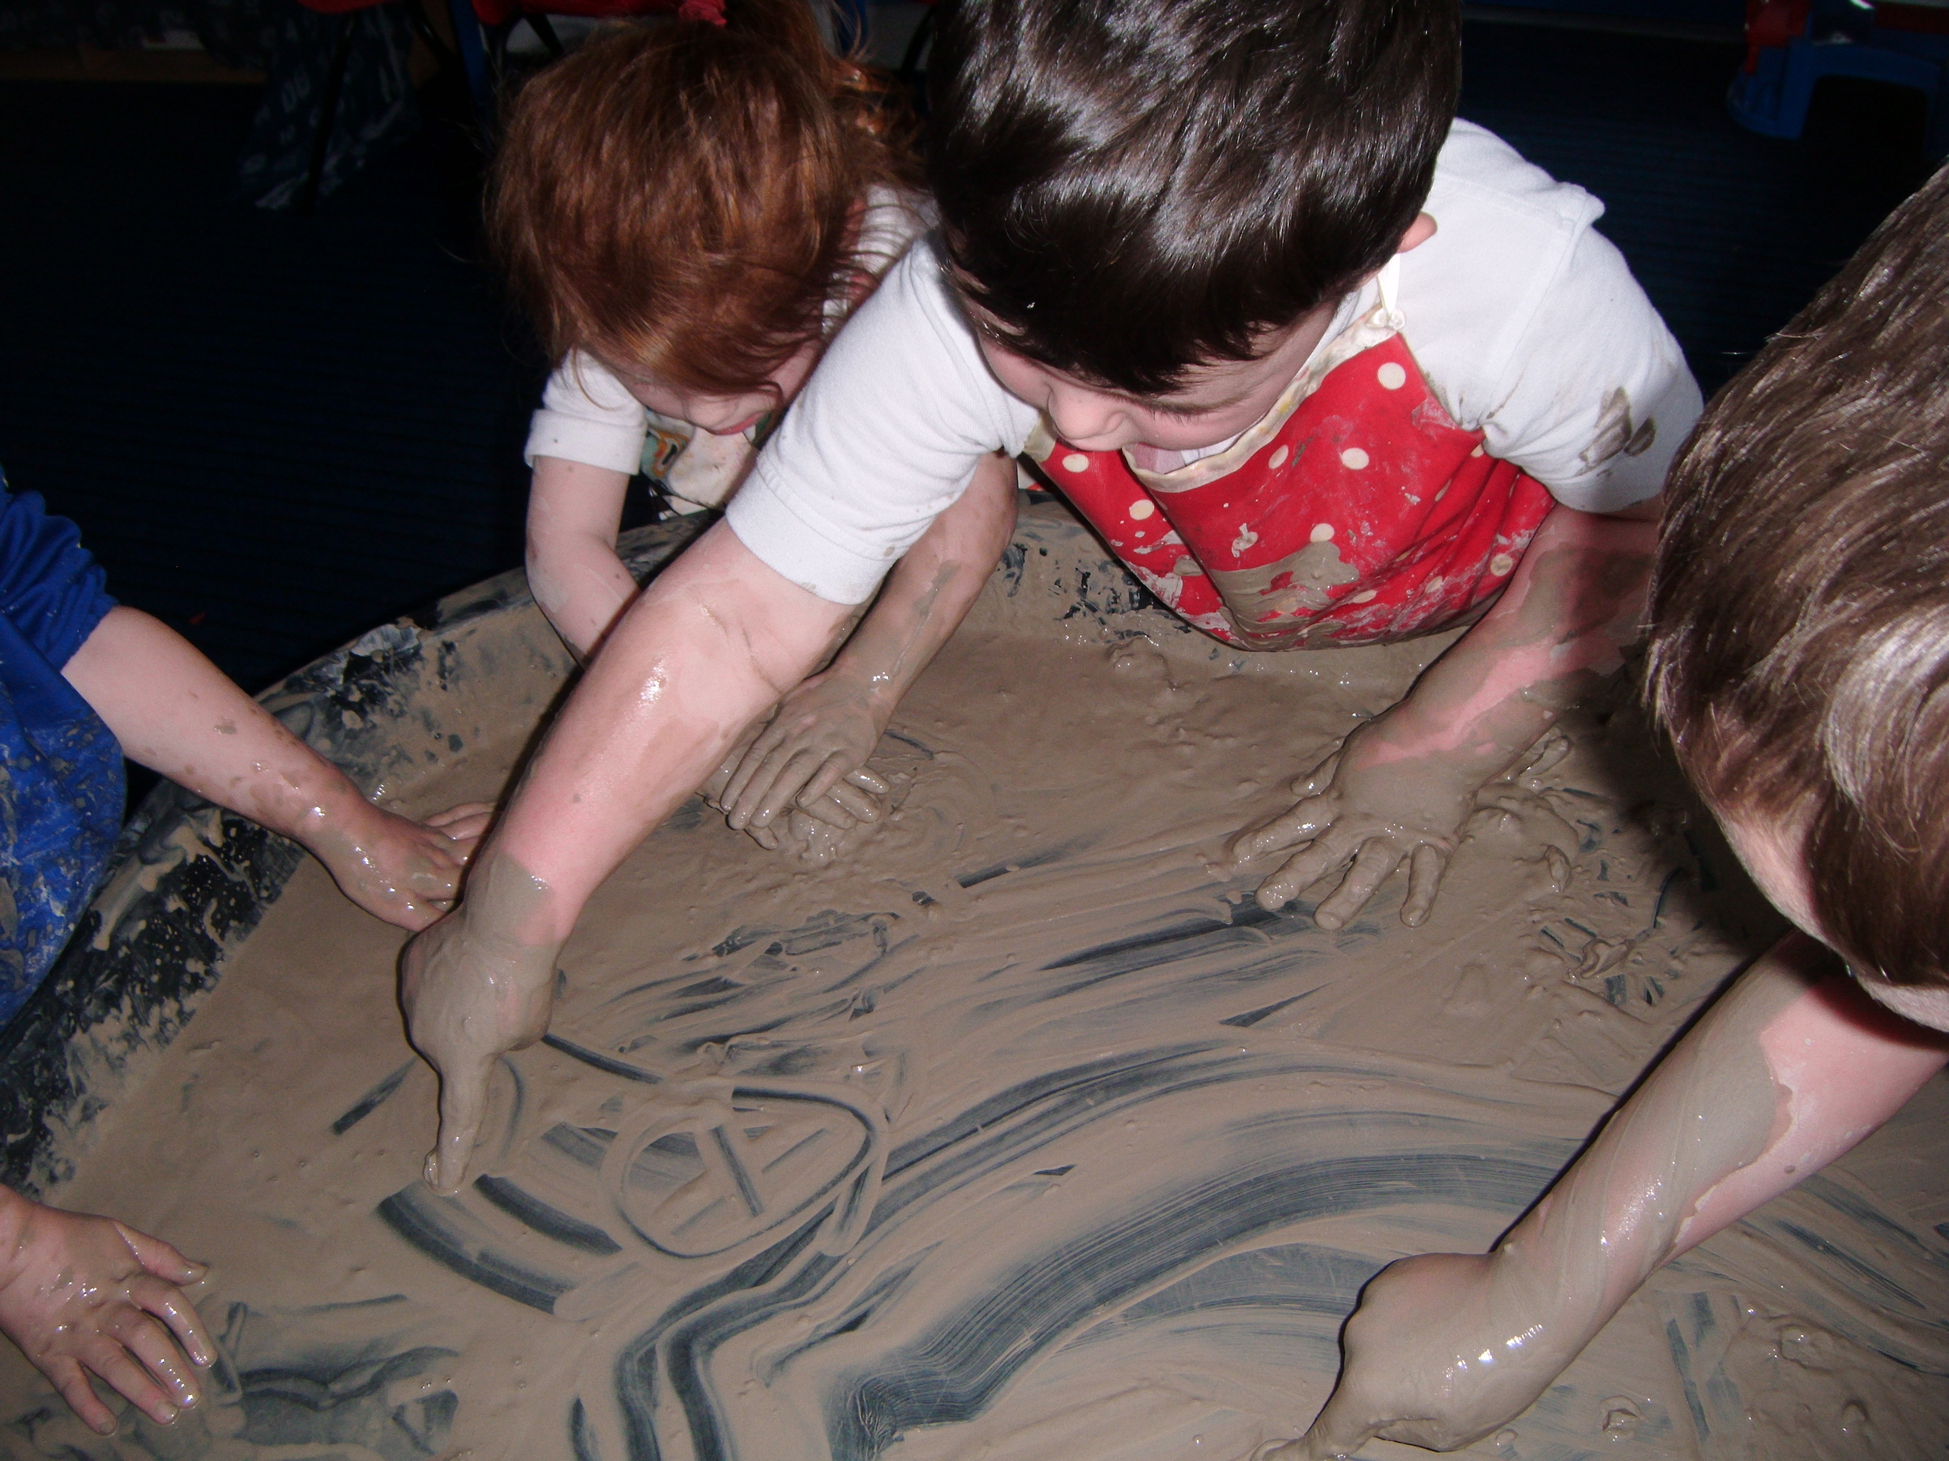
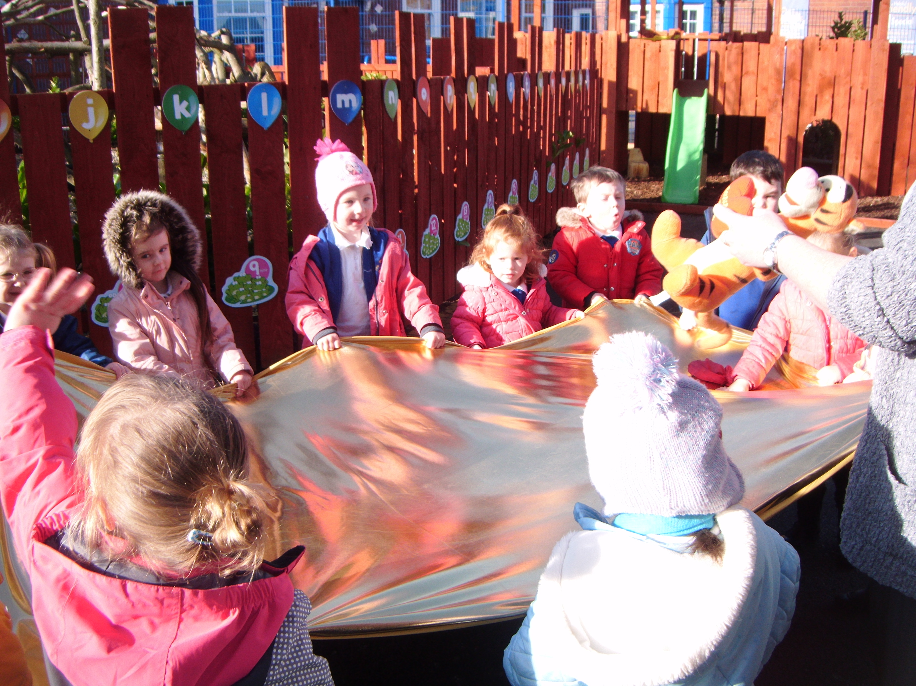
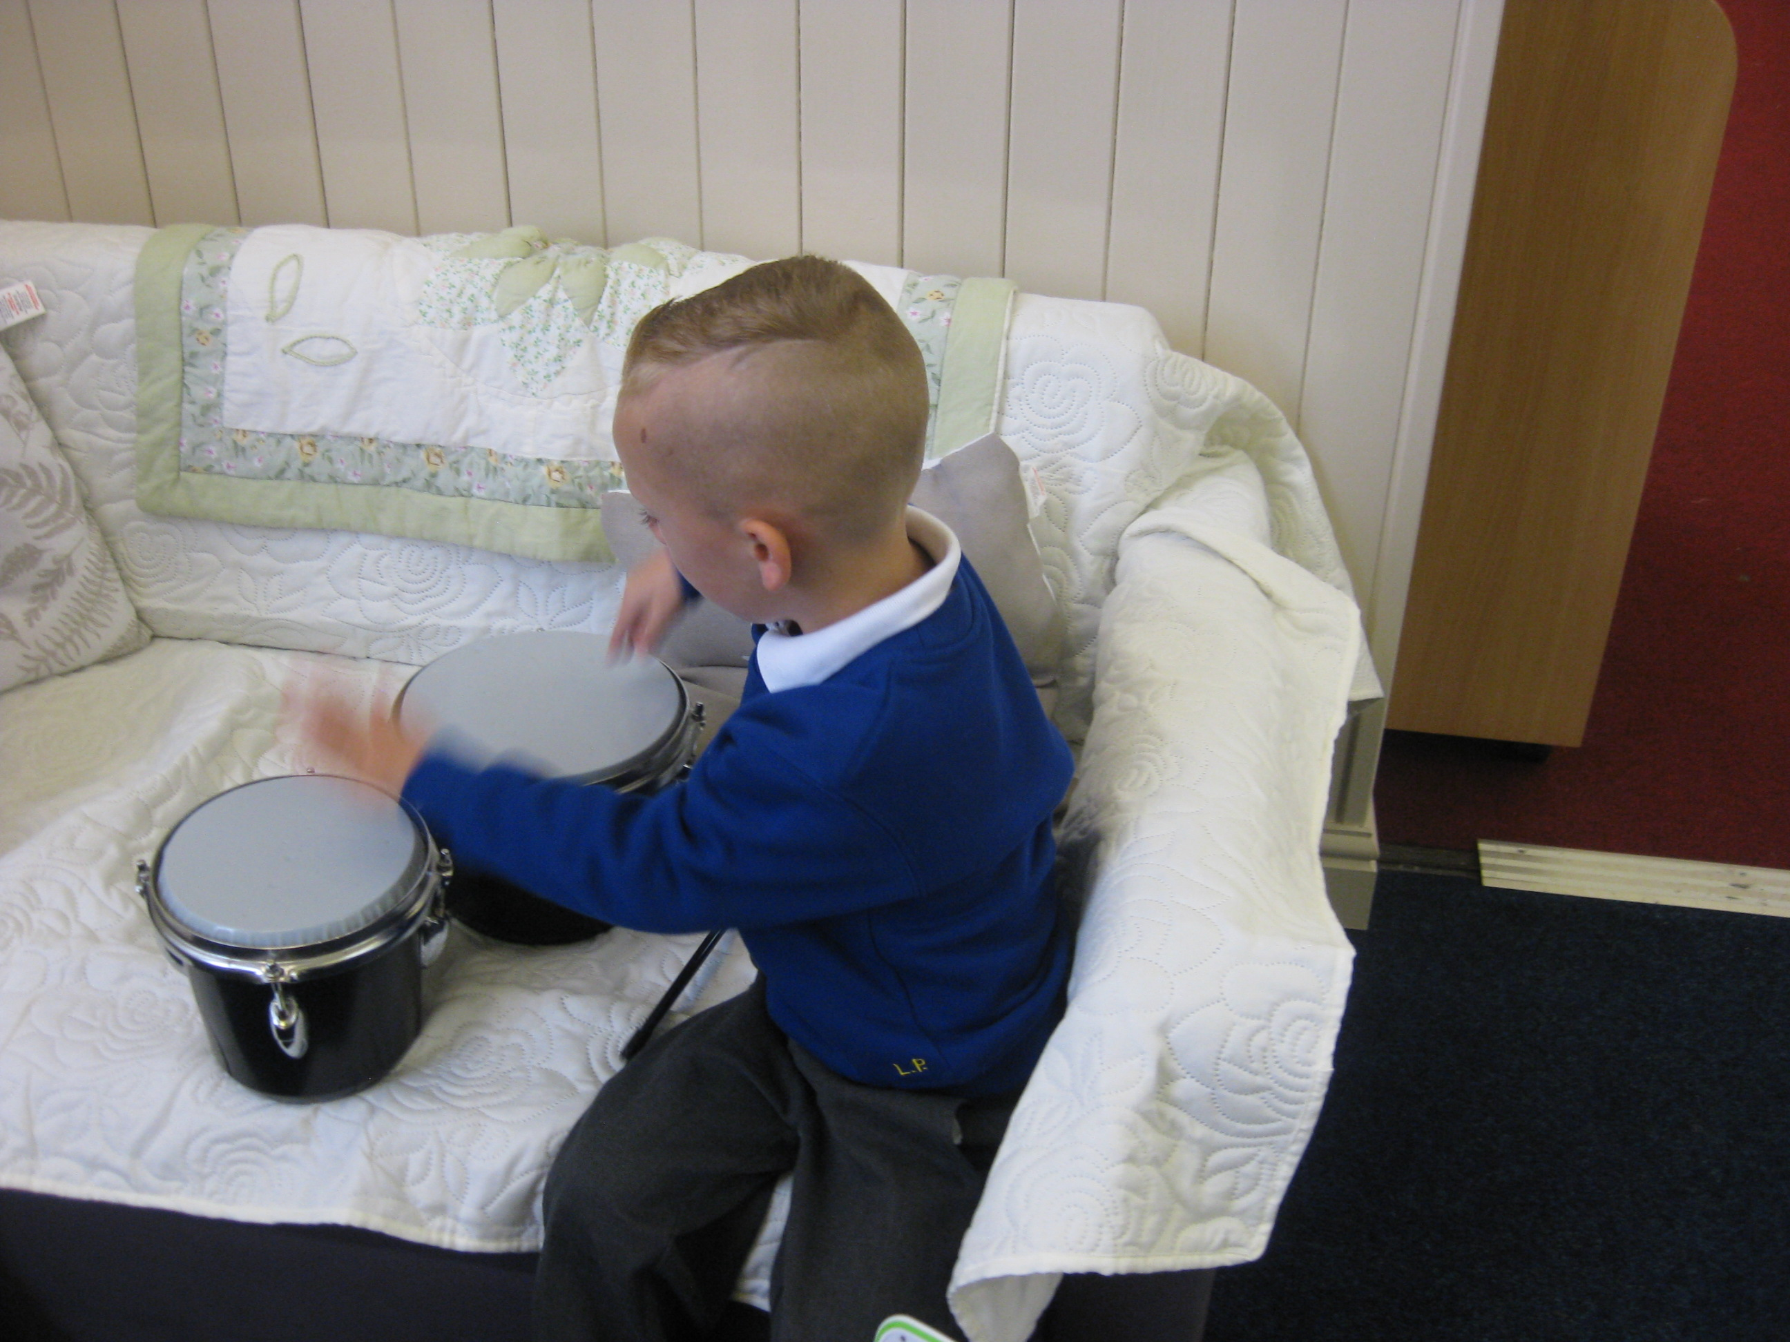
Key Experiences through
our Learning Landscape:
Blocks & Small World | ICT | Cooking/baking/snack
Books & Talk | Clay modelling | Outdoor Play & Gardening
Paint & colour mixing | Large construction | Mark-making
Role play | Sand, water & sensory | Music, movement & dance.
We are led by children’s interests as well as key events and seasonal changes.

Slide 8
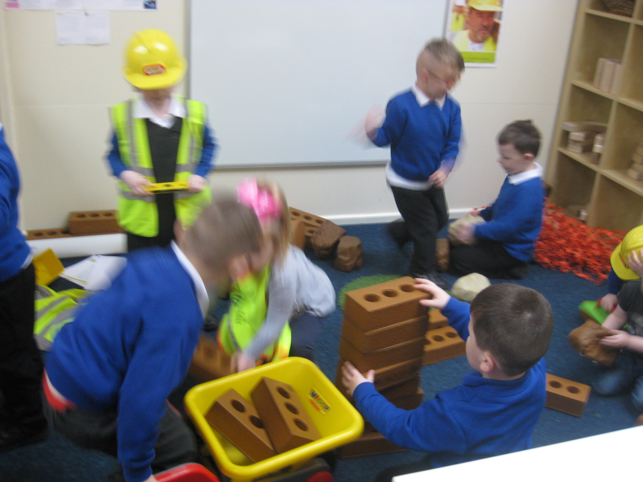
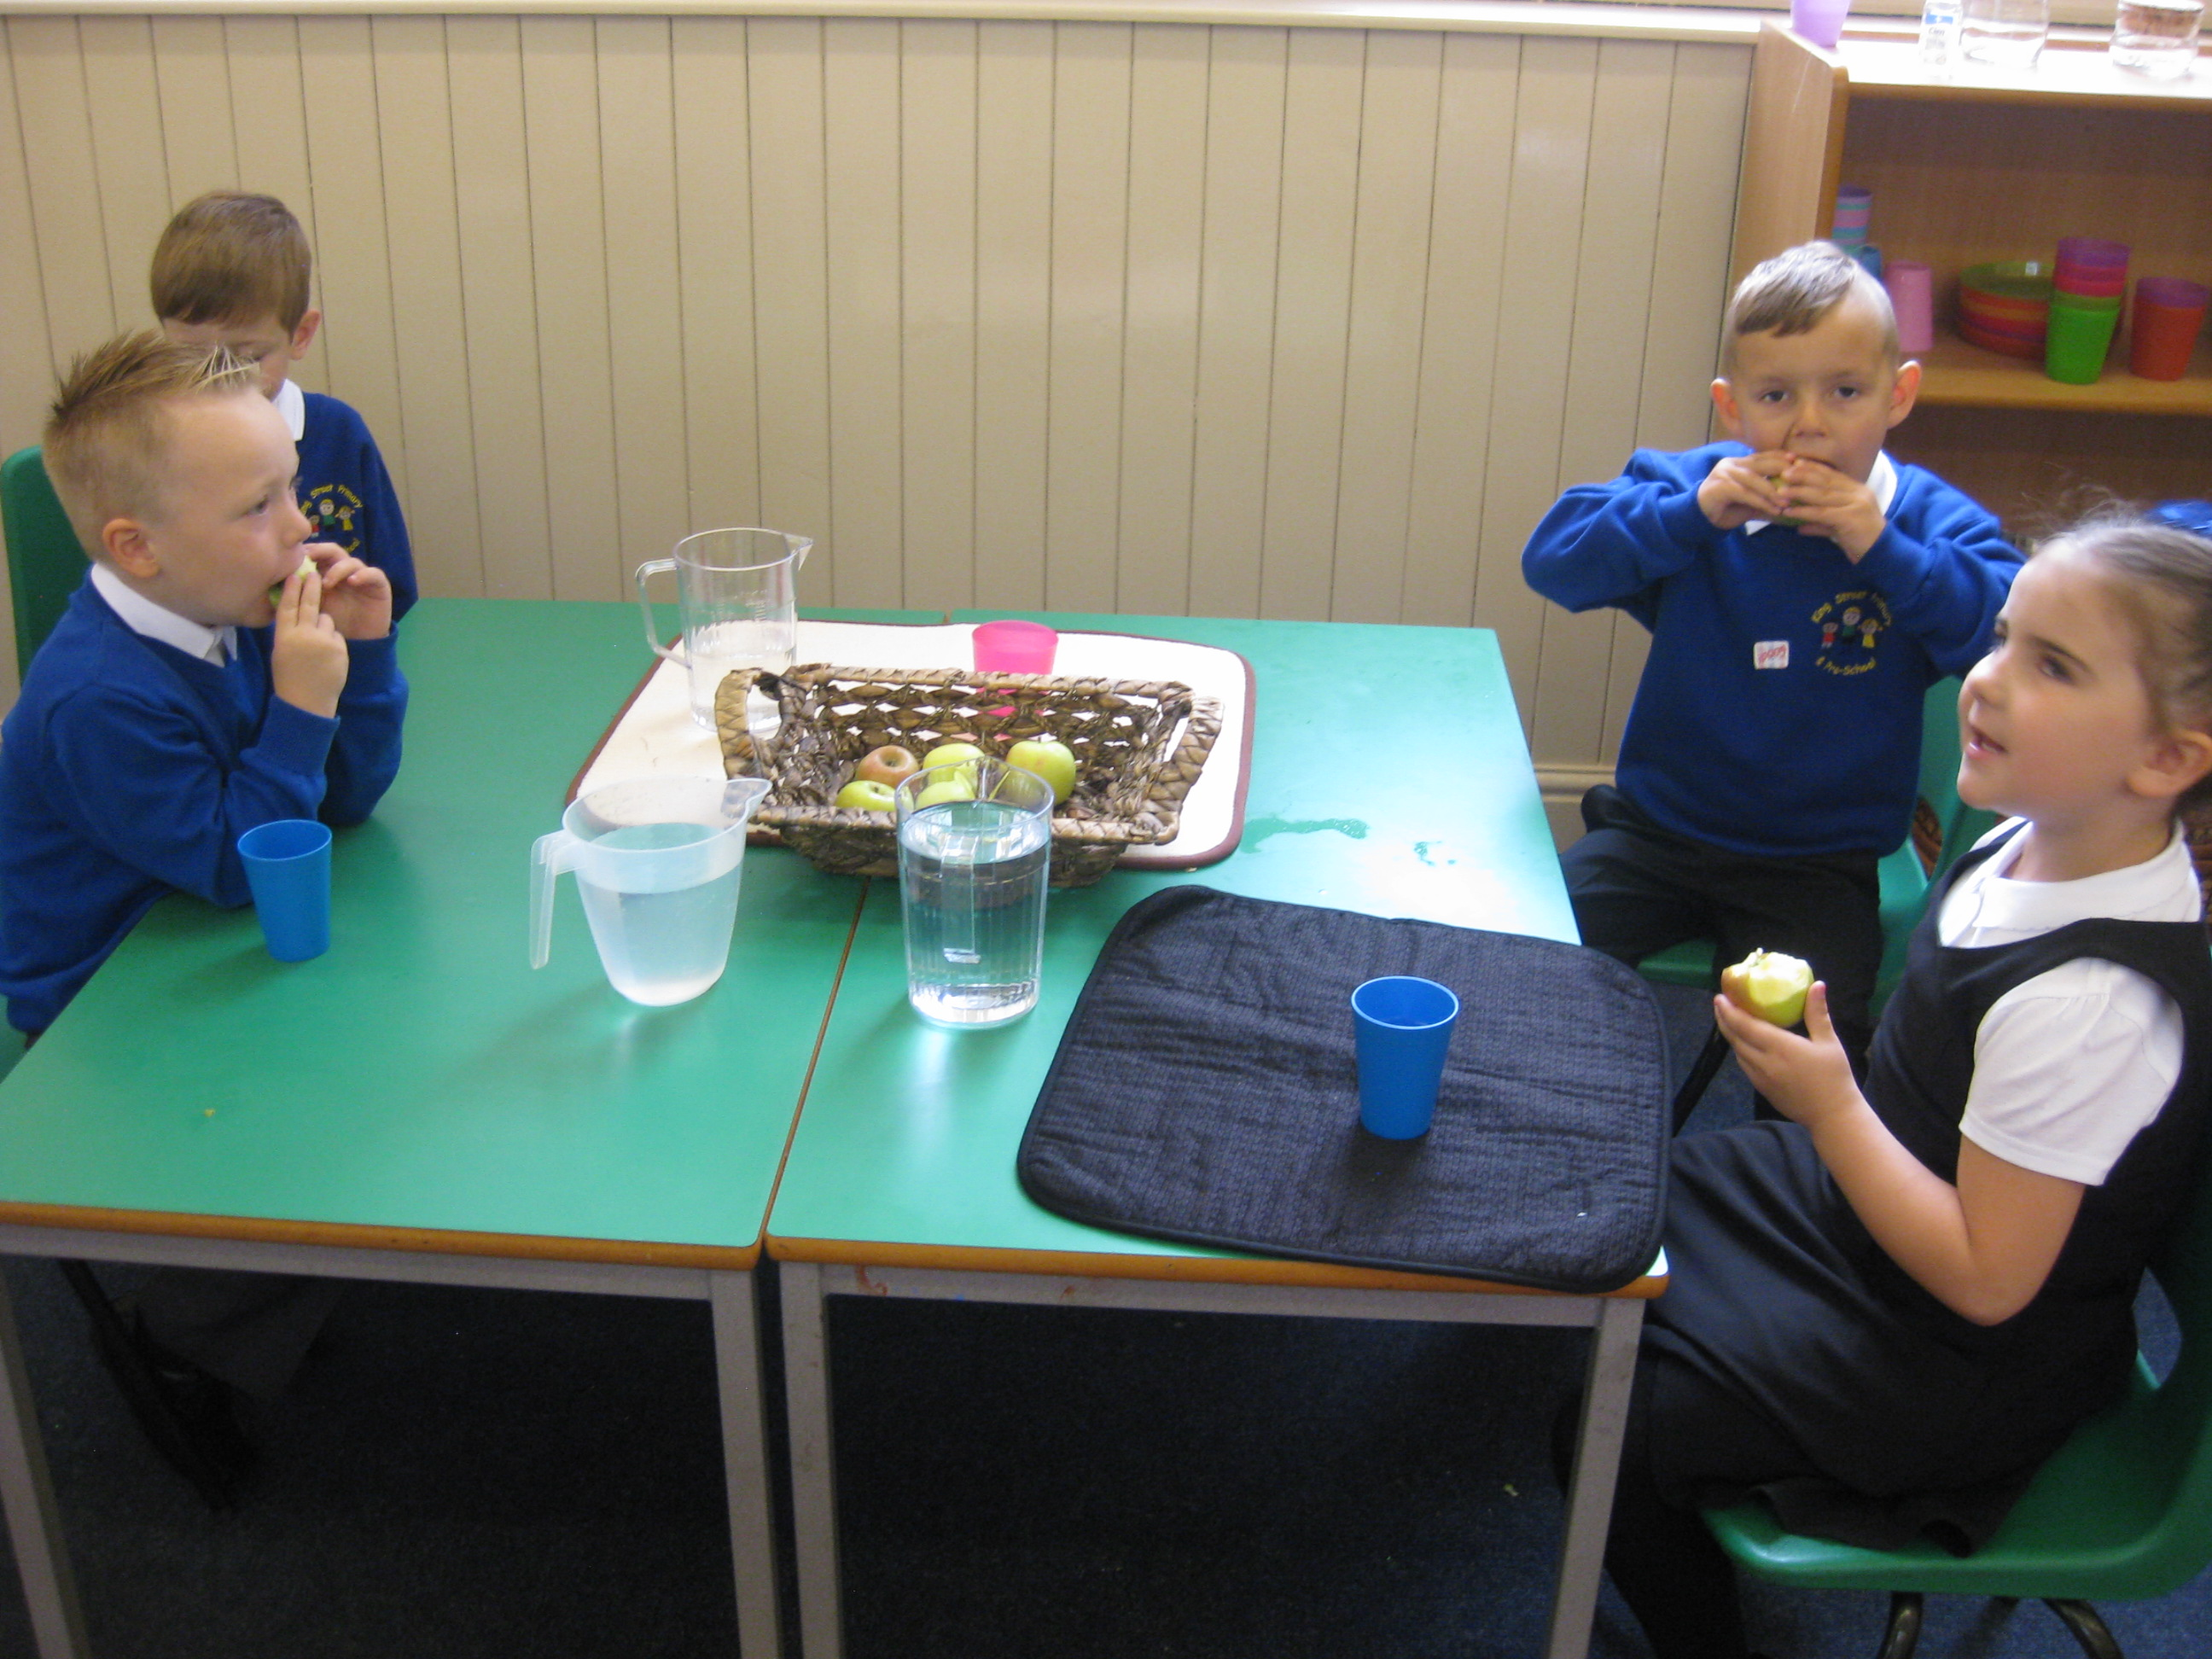
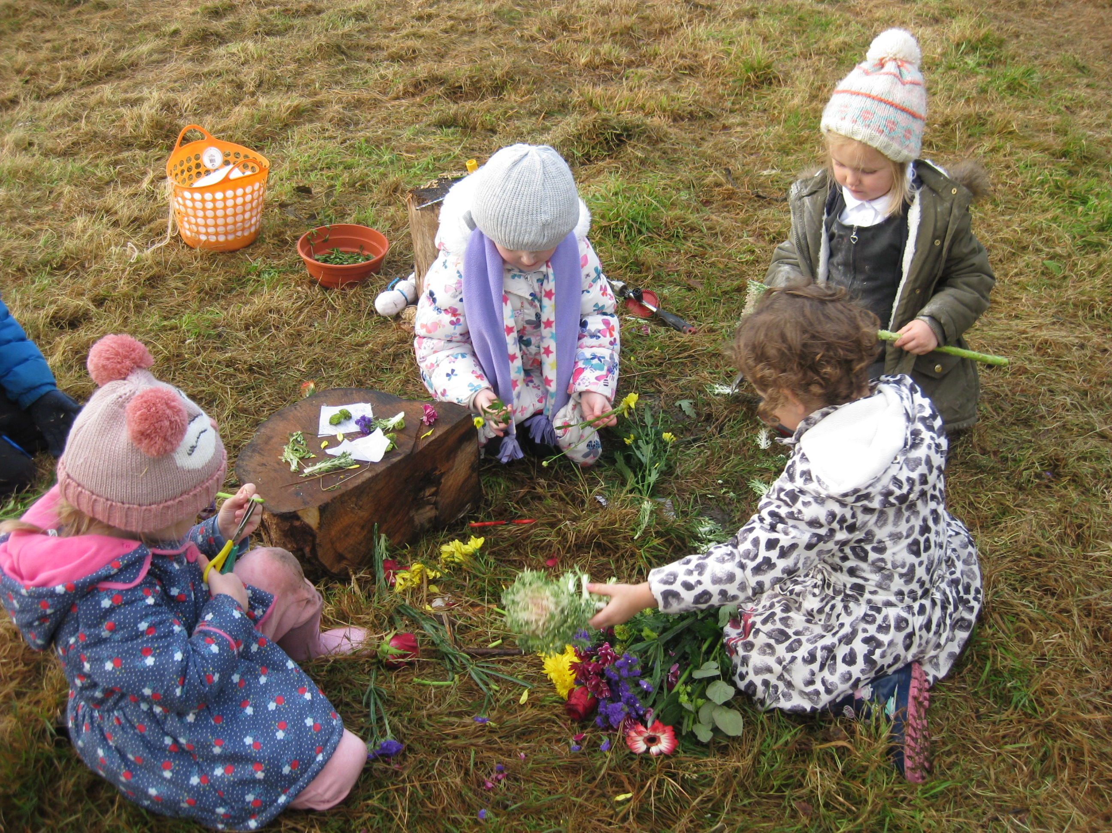
There is no such thing as a typical day in class…
Enter school and find peg and own name card.
Gather into Family Groups with Key Worker, register and talk about the day.
Indoor/Outdoor Activities.
Teacher-directed focused activities.
Daily phonics programme.
Rolling Snack Time (water, milk & fruit) children help themselves.
Tidy up time.
Coats/bags for lunch time/home time.
Children will have access to a Forest School session during the week where they will explore the wider environment , develop an awareness of changes around them and learn new skills.

Slide 9
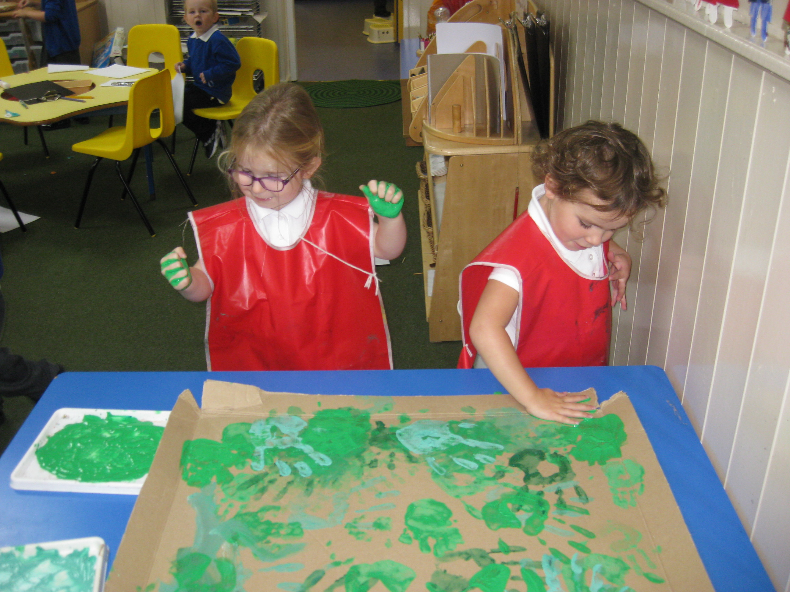
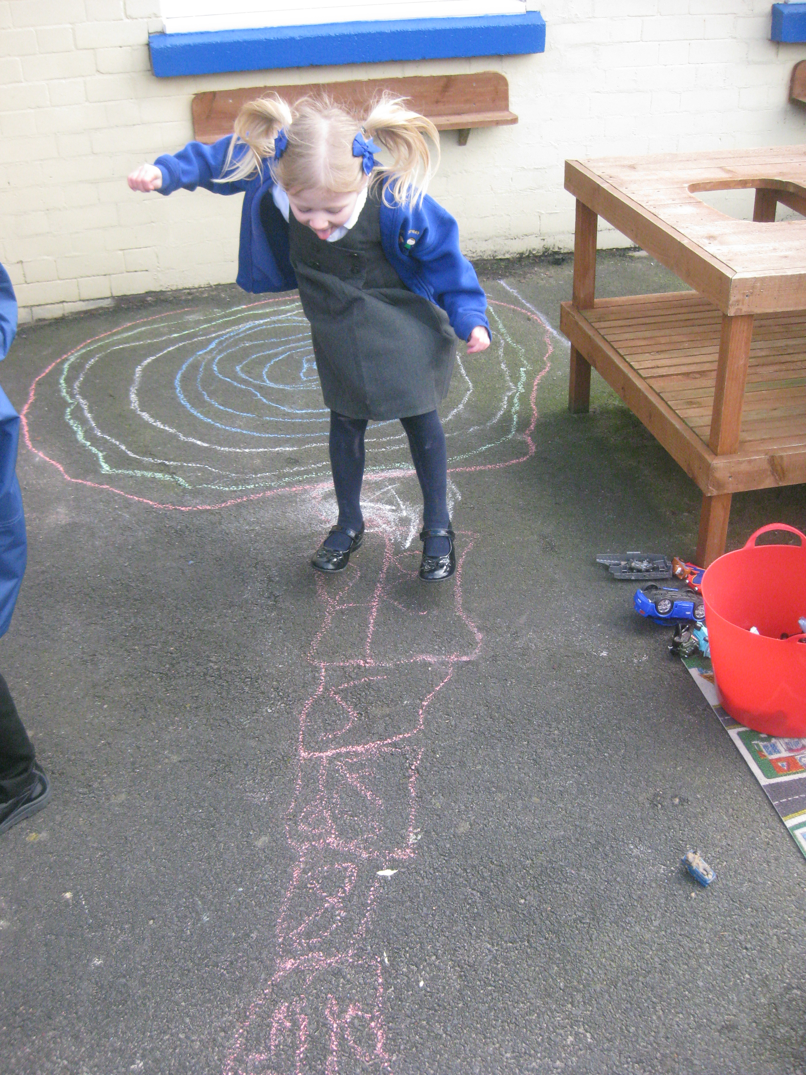
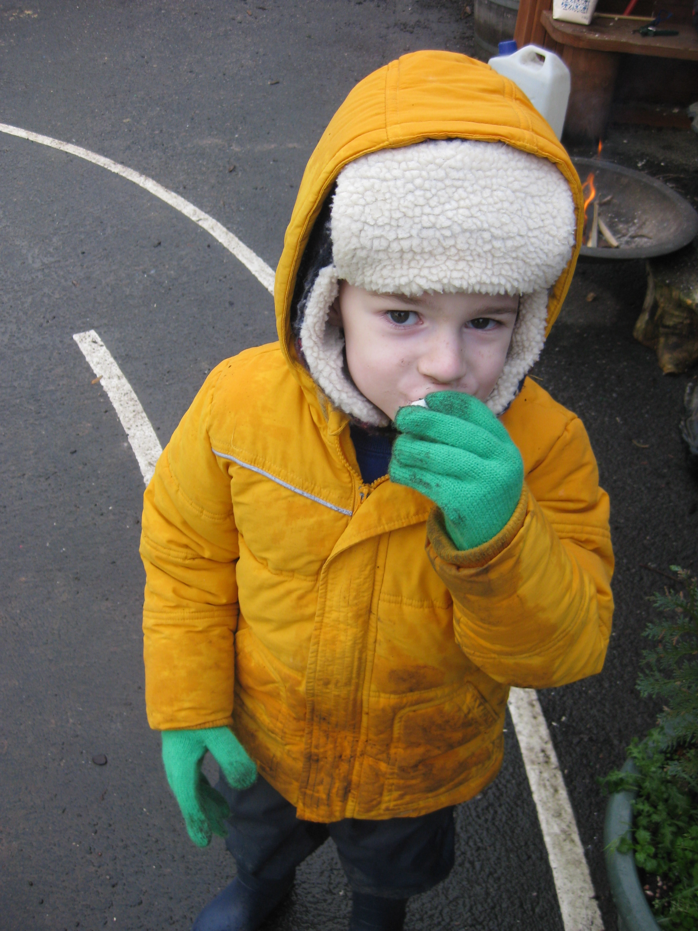
The first few weeks…
With your help, we will find out what the children already know and can do and use this information to help us develop an individual learning programme for each child.
Your child will get to know their key worker and they will work together with their Family Group in the different areas to find out what to do and help increase their independence.
Each child has their own online journal /learning journey using Tapestry where we keep and share evidence of their learning with samples of work and photographs or videos of what they have been doing. We also upload regular updates on work/topics completed in class so that you have a clear picture of what is being taught in school so that you can continue the learning at home. We work in close partnership with parents and carers to ensure we have a true picture of your child’s learning so that we can plan the next steps of their journey.

Slide 10
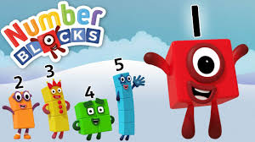

Home-School Partnership
How can you help at home?
Regular reading of reading book
Sharing books at bedtime
Reading key words
Counting everyday objects
Talking about weights/heights
Send in journal contributions
Talk to us…we are here to help!
Volunteers are always warmly welcomed!

Slide 11
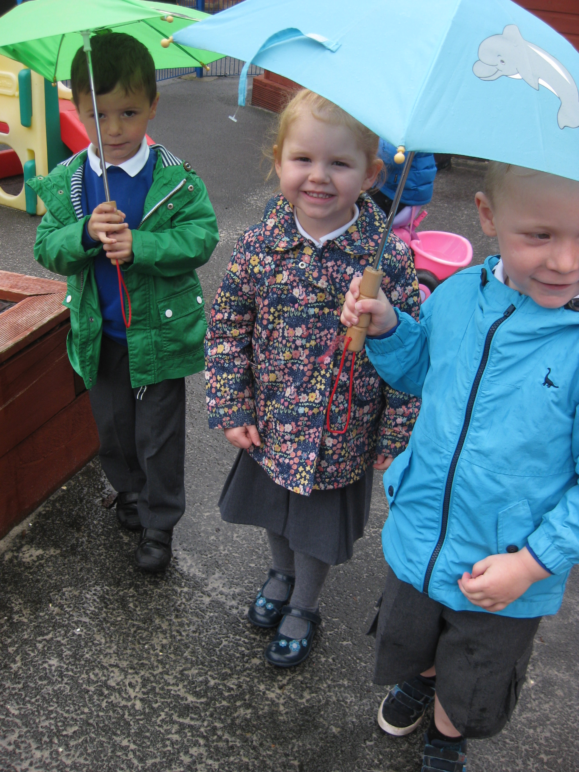
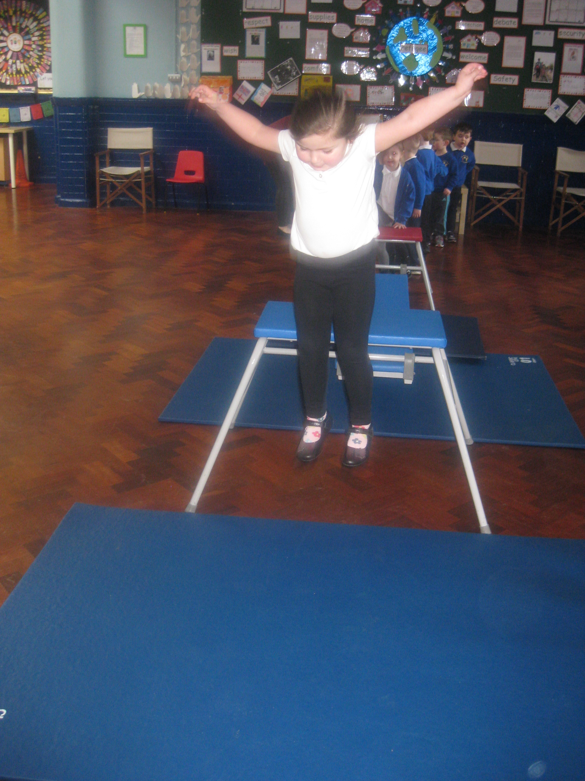
Medical Matters
We do encourage outstanding attendance to our setting and offer rewards to children who manage to maintain 100% attendance. However, we appreciate that children do become unwell and are unable to attend school.
Any sickness or diarrhoea, must be followed by 48 hrs absence.
Any absence requires a message or telephone call to school before 9am explaining why.
Head lice are common! Please check regularly and treat as recommended.
Prescribed medicines can be administered once a form from the office has been completed.

Slide 12

Safeguarding
At King Street Primary School we have a duty of care to your children to ensure they are safe and cared for.
Please ensure that we have up to date contact information so that we are able to contact you if there is a problem. Please call into our office with new phone numbers or addresses so that we can update our systems.
Please let us know if someone different will be collecting your child. We appreciate that there may be times when someone is asked to do so at the last moment, but we would appreciate it if you could call school and sometimes giving the adult a password (such as a pet’s name) so that we can verify their identity.
If there are any issues at home, please let your child’s Key Person know. We are here to support you and your child.

Slide 13

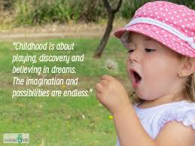
Our journey starts here…

