Slide 1
Welcome to year 3
Mrs. Heightley, Miss Brown, Mr Swift

Slide 2
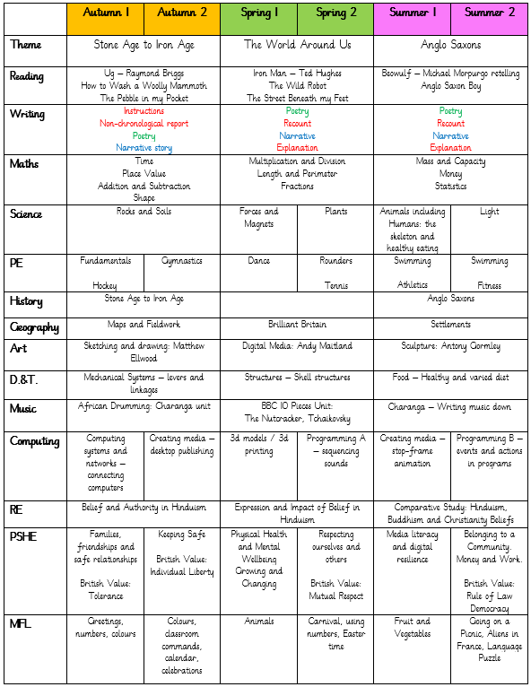
Our Learning
This is our curriculum map. It gives an overall idea of what we will be learning in each subject in each term during the year.

Slide 3
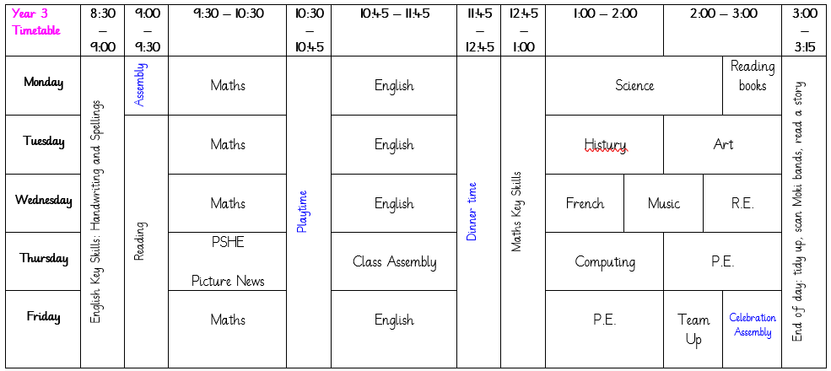
Our Learning
This is an example of a weekly timetable in Year 3. Please be aware that this is an example only as our timetable is entirely flexible and there are times when things have to be moved around to accommodate various events and activities that might be happening in school on a particular day.

Slide 4
Uniform & P.E. kit
Uniform
Children should all come to school wearing: black or grey trousers/shorts/skirt/pinafore; a white polo shirt; a blue cardigan/sweatshirt; and plain black shoes. We have thought carefully about how to keep our uniform costs manageable for families, but if there are any difficulties with providing uniform, please do let us know as we can support with this.
P.E.
For the Autumn term, our PE lessons will take place on a Thursday and Friday. For Autumn 1, the majority of these lesson will take place outside. Please send PE kits in to school with your child on a Monday, and these will be sent home on Fridays. PE kit should consist of: tracksuit bottoms, trainers and a change of top (preferably a t-shirt in house colours or a plain white t-shirt), as well as a sweatshirt for the outdoors.

Slide 5
Swimming
Year 3 will have swimming lessons during the Summer term and will need the following kit:
A swimming costume for girls (no bikinis)
Swimming shorts for boys (not board shorts and not longer than the knee)
A swimming hat (boys and girls)
A towel
Goggles (your child is welcome to wear goggles but they are not essential)
A suitable bag to carry all the kit in (preferably waterproof)

Slide 6
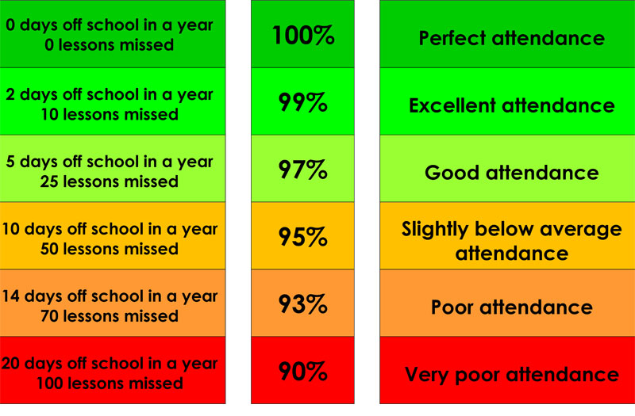
Attendance & Lateness
Every single day a child is absent = one day of learning lost
Being at school on time (Early Bird starts at 8:30 a.m.) allows your child to feel settled and prepared for their day.

Slide 7

Reading
We are passionate about reading in school, and believe that it is the single most important skill to give your child. It opens up the whole world to them!
Please support by hearing your child read, and signing their Reading Record, at least three times a week. and letting us know if you have any concerns.
During Year 3, we encourage and develop children’s reading fluency along with improving their vocabulary and comprehension.

Slide 8
Other Ways to Help at Home
Regular reading
Times tables
Telling the time
Cooking & baking
Get outdoors
Sleep

Slide 9

Expectations of Behaviour & Gem Powers
We have high expectations of our children, encouraging kindness, focus and self-regulation.
Visitors and members of the public always comment on the excellent behaviour of the children!
We encourage this through our Gem Powers:
Being responsible
Being kind
Being resilient
Collaborating
Focusing
Co-operating

Slide 10
Contact Information
Teachers are available on the school yard either before or after school for any concerns or questions.
If you would prefer to make an appointment, you can do so through the school office.
Teachers can also be contacted directly via email. Please be aware, as a school we support a healthy work-life balance and do not expect staff to respond outside of working hours so do be mindful of this!
s.wigham100@kingstreet.durham.sch.uk
j.kane103@kingstreet.durham.sch.uk (SENDCo)

