Slide 1
Welcome to year 1
Miss Simpson and Mrs Atkinson
Miss Boe will join us when Mrs Atkinson is on her maternity leave.

Slide 2
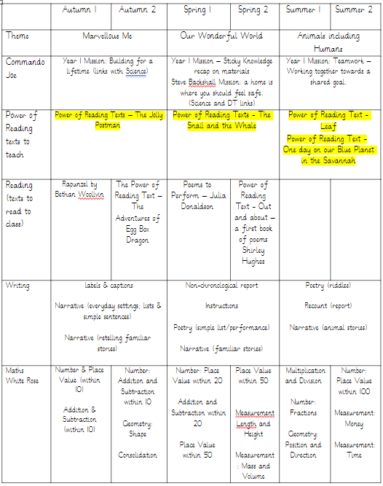
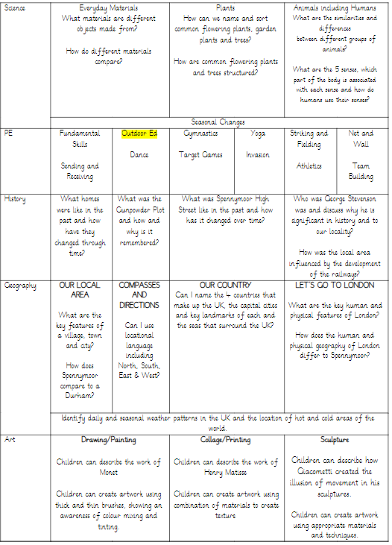
Our Learning

Slide 3
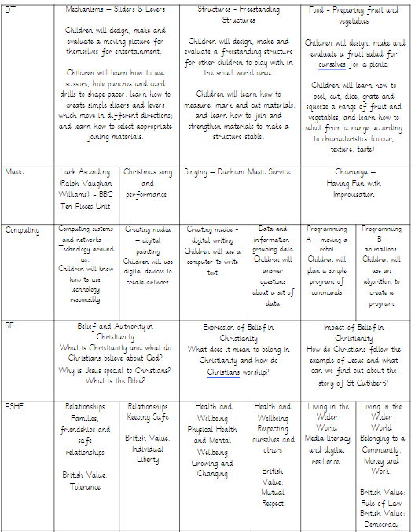
Our Learning

Slide 4
Uniform & PE kit
PE
Our PE lessons will usually take place on Tuesdays and Wednesdays; please send PE kits in to school with your child on a Monday, and these will be sent home on Friday to be washed.
PE kit should consist of: shorts/tracksuit bottoms, trainers and a T-shirt (colour depends on house team) as well as a sweatshirt for the outdoors.
Please ensure that your child’s name is written on the labels.
Uniform
Children should all come to school wearing: black or grey trousers/shorts/skirt/pinafore; a white polo shirt; a blue cardigan/sweatshirt; and plain black shoes. Please ensure that your child’s name is written on the labels.
We have thought carefully about how to keep our uniform costs manageable for families, but if there are any difficulties with providing uniform, please do let us know as we can support with this.

Slide 5
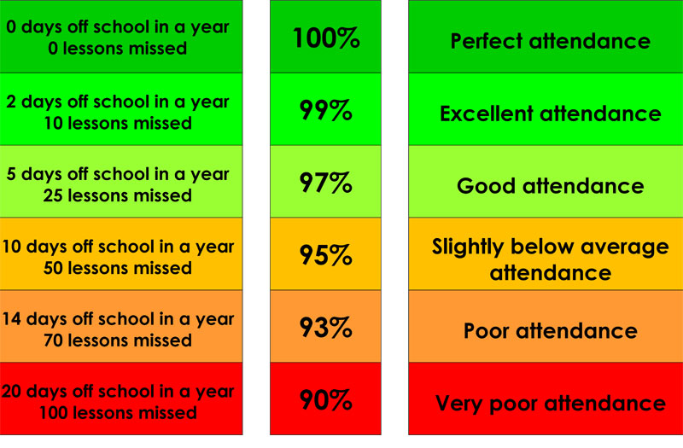
Attendance & Lateness
Every single day a child is absent = one day of learning lost
Being at school on time (Early Bird starts at 8.30am) allows your child to feel settled and prepared for their day.

Slide 6
Outdoor Education
We will be starting Outdoor Education after the October half term. More information to follow in the form of a letter regarding dates.
Please ensure your child has suitable clothing for outdoor ed.
Waterproofs
A coat with a hood suitable for the cold weather
Wellies or walking boots
Hat scarf and gloves
Please send your child in clothing that you don’t mind getting muddy or dirty!
In addition, we will be using the local area as much as possible for trips (such as reflection visits to St. Andrew’s Church, Spennymoor Town Library) to extend and enrich your child’s learning.

Slide 7
Home Learning
Homework will be set through a combination of online platforms and your child’s Home Learning book.
This will be set on a Monday to be completed by Friday.
Children will shortly be given individual log ins for Purple Mash and Numbots.
Please look out for these in their reading record/home learning book.

Slide 8

Reading
We are passionate about reading in school, and believe that it is the single most important skill to give your child. It opens up the whole world to them!
Please support by hearing your child read at least three times a week, and letting us know if you have any concerns.

Slide 9
Year 1 Phonics Check
This takes place in June.
The children will use their knowledge of letter sounds to blend and read real and nonsense words.
We will do lots of work around phonics this year, but please support us at home with lots of regular reading.

Slide 10

Expectations of Behaviour & Gem Powers
We have high expectations of our children, encouraging kindness, focus and self-regulation.
Visitors and members of the public always comment on the excellent behaviour of the children!
We encourage this through our Gem Powers:
Being kind
Being responsible
Being resilient
Co-operating
Collaborating
Focusing

Slide 11
Contact Information
Teachers are available each morning on the school yard for any concerns or questions.
Teachers can also be contacted directly via email.
Please be aware, as a school we support a healthy work-life balance and do not expect staff to respond outside of working hours so do be mindful of this!
r.simpson300@kingstreet.durham.sch.uk

Slide 12
Further Contact Information
j.kane103@kingstreet.durham.sch.uk
SENDCO
n.livesley300@kingstreet.durham.sch.uk
Pastoral Support & SEMH

Slide 13
Any questions?

