Slide 1
Welcome to Year 2!

Slide 2
Staff in Year 2
Miss Bell
Miss Boe (part time)
Mrs McGonigal

Slide 3
Daily Routine
8.30am – door open
8.45am – registers are taken and English key skills tasks begin
Morning and afternoon play time in Key Stage 1
Continuous provision areas are still set up in Year 2 e.g. the construction area, creative area.
At the end of the day, we ask the children to wait with us until we’ve seen the adult who is collecting them.

Slide 4
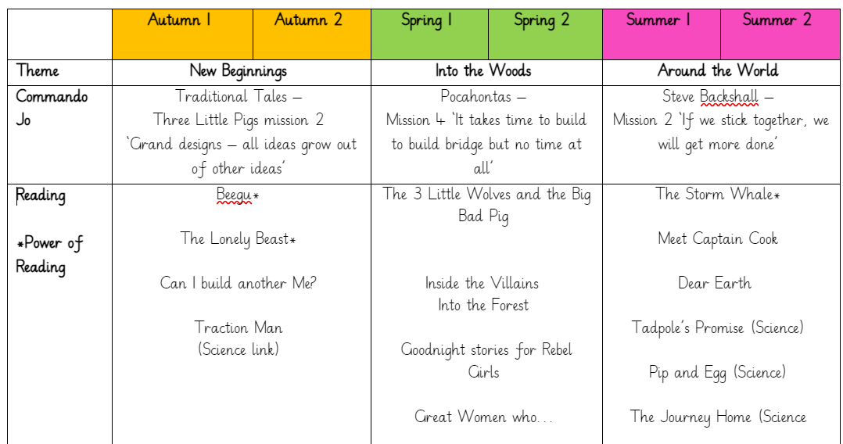
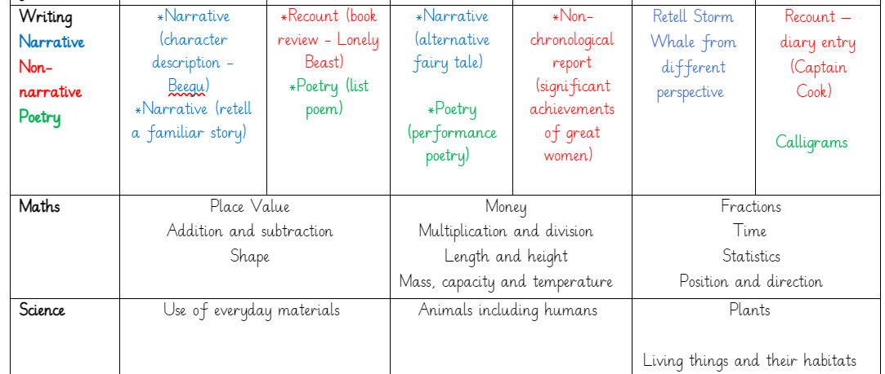
Our Learning

Slide 5
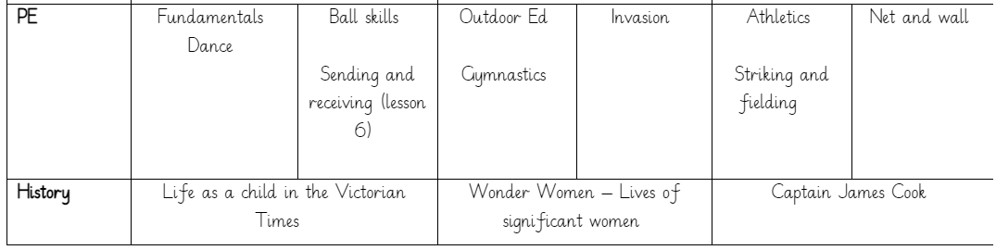
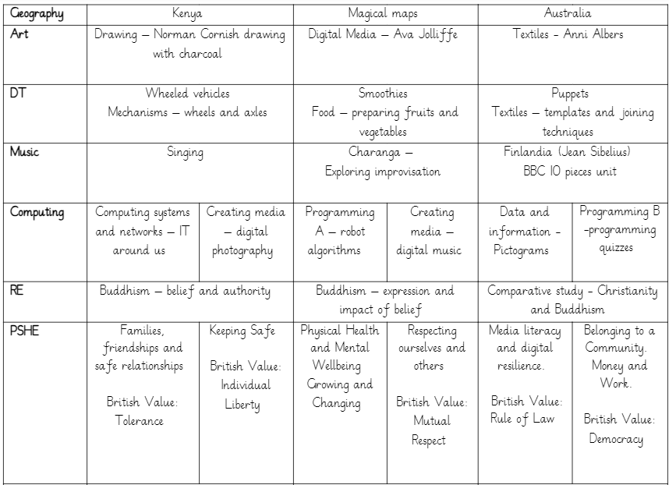
Our Learning

Slide 6

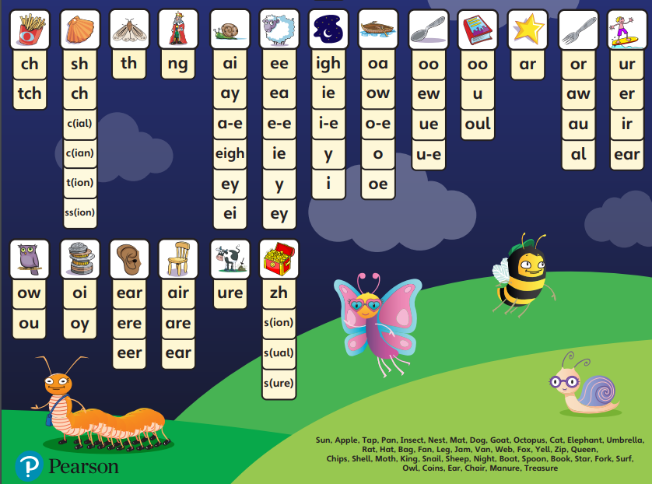
Phonics
Phonics lessons will continue in the Autumn term in Year 2 where we will continue to learn alternative graphemes (ways of spelling) different phonemes (sounds)
Any children who didn’t pass the Phonics Screening Check in Year 1 will also receive a phonics intervention daily. They will then retake the Check in June 2025.

Slide 7
PE
We will have PE lessons twice a week – currently on a Wednesday and Thursday.
Please send PE kits in to school with your child on a Monday, and these will be sent home on Fridays. PE kit should consist of: tracksuit bottoms, trainers and a change of top (preferably a school t-shirt in house colours or plain white t-shirt), as well as a sweatshirt for the outdoors.
Any ear piercings must be removed or covered on PE days. As staff are not permitted to help children do so, please ensure earrings are removed at home, before school on these days or have plasters to cover them.

Slide 8


Uniform
Children should all come to school wearing: black or grey trousers/shorts/skirt/pinafore; a white polo shirt; a blue cardigan/sweatshirt; and plain black shoes. We have thought carefully about how to keep our uniform costs manageable for families, but if there are any difficulties with providing uniform, please do let us know as we can support with this.
Free uniform is available from our Community Hub – check the newsletter for further details.
Please ensure all items of clothing (including shoes and wellies)
We will also be uploading regular updates to our school Facebook page. If you haven’t joined yet, just search for ‘King Street Primary School – The Home of Active Ted’. We will ensure that we have photographic permission before uploading any photos of the children.
Facebook

Slide 9
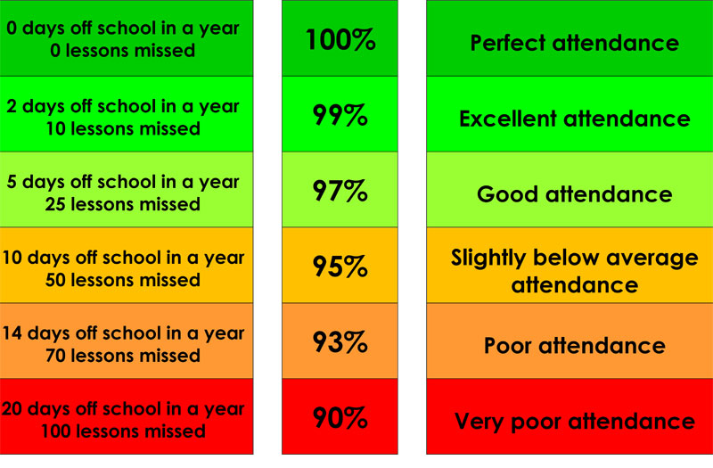
Attendance & Lateness
Every single day a child is absent = one day of learning lost
Being at school on time (Early Bird starts at 8.30am) allows your child to feel settled and prepared for their day. The register is taken at 8.45am.

Slide 10

Reading
Children will bring home a reading book each week and will keep that book for the full week. We encourage them to re-read the book to build their fluency where they read the words without needing to blend the sounds.
Please ensure your child brings their reading book into school every day as staff will read with them throughout the day / week.
Please support us by reading with your child at home at least 3 times a week and signing their reading record (you don’t need to write a comment).

Slide 11
Helping At Home
Regular reading and phonics – at least 3 times per week.
Counting forwards and backwards within 100
Times tables – 2s, 5s and 10s
Letter and number formation
Telling the time
Recognising and using money
Cooking & baking (using measurements)
Get outdoors
Sleep!

Slide 12

Expectations of Behaviour & Gem Powers
We have high expectations of our children, encouraging kindness, focus and self-regulation.
Visitors and members of the public always comment on the excellent behaviour of the children!
We encourage this through our Gem Powers:
Being kind
Being responsible
Being resilient
Co-operating
Collaborating
Focusing

Slide 13
Contact Information
Teachers are available each morning on the school yard for any concerns or questions.
If you would prefer to make an appointment, you can do so through the school office.
Teachers can also be contacted directly via email. Please be aware, as a school we support a healthy work-life balance and do not expect staff to respond outside of working hours so do be mindful of this!
e.bell300@kingstreet.durham.sch.uk

